Slide 1


Understanding the
Appraisal Process
IRWA Chapter 67 - 2019 Summer Seminar
Presented by
Matthew VanEck, MAI
Kidder Mathews
Irvine, CA
949.557.5047

Slide 2
Topics of Discussion
Regulations & Guidelines
Appraisal Process
Valuation Methodology
Project Examples
Areas of Concern

Slide 3
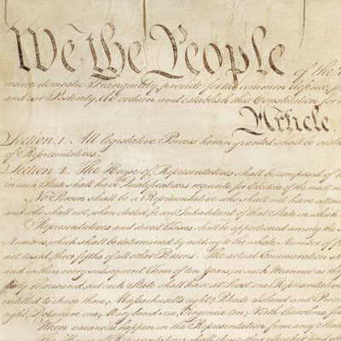
Regulations & Guidelines
5TH AMENDMENT TO THE US CONSTITUTION:
…nor shall private property be taken for public use, without
just compensation.
ARTICLE I, SECTION 19 OF CALIFORNIA CONSTITUTION:
“(a) Private property may be taken or damaged for a public use and only when just compensation, ascertained by a jury unless waived, has first been paid to, or into court for, the owner.”

Slide 4
Regulations & Guidelines
WHAT IS JUST COMPENSATION AND HOW IS IT MEASURED?
Section 1263.310 of Title 7 (Eminent Domain Law) of the California Code of Civil Procedure (CCP):
“Compensation shall be awarded for the property taken. The measure
of this compensation is the fair market value of the property taken.”

Slide 5
Regulations & Guidelines
DEFINITIONS OF MARKET VALUE
Section 1263.320 of the California Code of Civil Procedure:
“(a) The fair market value of the property taken is the highest price on the date of valuation that would be agreed to by a seller, being willing to sell but under no particular or urgent necessity for so doing, nor obliged to sell, and a buyer, being ready, willing and able to buy but under no particular necessity for so doing, each dealing with the other with full knowledge of all the uses and purposes for which the property is reasonably adaptable and available.”
(b) The fair market value of property taken for which there is no relevant, comparable market is its value on the date of valuation as determined by any method of valuation that is just and equitable.”

Slide 6
Regulations & Guidelines
DEFINITIONS OF MARKET VALUE (CONTINUED)
Office of the Comptroller of the Currency under 12 CFR, Part 34, Subpart C-Appraisals, 34.42 Definitions [h]:
“Market value means the most probable price which a property should bring in a competitive and open market under all conditions requisite to a fair sale, the buyer and seller each acting prudently and knowledgeably, and assuming the price is not affected by undue stimulus…

Slide 7
Regulations & Guidelines
DEFINITIONS OF MARKET VALUE (CONTINUED)
…Implicit in this definition is the consummation of a sale as of a specified date and the passing of title from seller to buyer under conditions whereby:
Buyer and seller are typically motivated;
Both parties are well informed or well advised, and acting in what they consider their own best interests;
A reasonable time is allowed for exposure in the open market;
Payment is made in terms of cash in U.S. dollars or in terms of financial arrangements comparable thereto; and
The price represents the normal consideration for the property sold unaffected by special or creative financing or sales concessions granted by anyone associated with the sale.”

Slide 8
Regulations & Guidelines
TITLE 7 (EMINENT DOMAIN LAW) OF CCP
Project Influence
§1263.330: The fair market value of the property taken shall not include any increase or decrease in the value of the property that is attributable to any of the following:
(a) The project for which the property is taken.
(b) The eminent domain proceeding in which the property is taken.
(c) Any preliminary actions of the plaintiff relating to the taking of the property.

Slide 9
Regulations & Guidelines
TITLE 7 (EMINENT DOMAIN LAW) OF CCP
Severance Damages and Project Benefits
§1263.410: (a) Where the property acquired is part of a larger parcel, in addition to the compensation awarded […] for the part taken, compensation shall be awarded for the injury,
if any, to the remainder.
(b) Compensation for injury to the remainder is the amount of the damage to the remainder reduced by the amount of the benefit to the remainder.
§1263.420: Damage to the remainder is the damage, if any, caused to the remainder by either or both of the following:
(a) The severance of the remainder from the part taken.
    (b) The construction and use of the project for which the property is taken in the manner proposed by the plaintiff whether or not the damage is caused by a portion of the project located on the part taken.

Slide 10
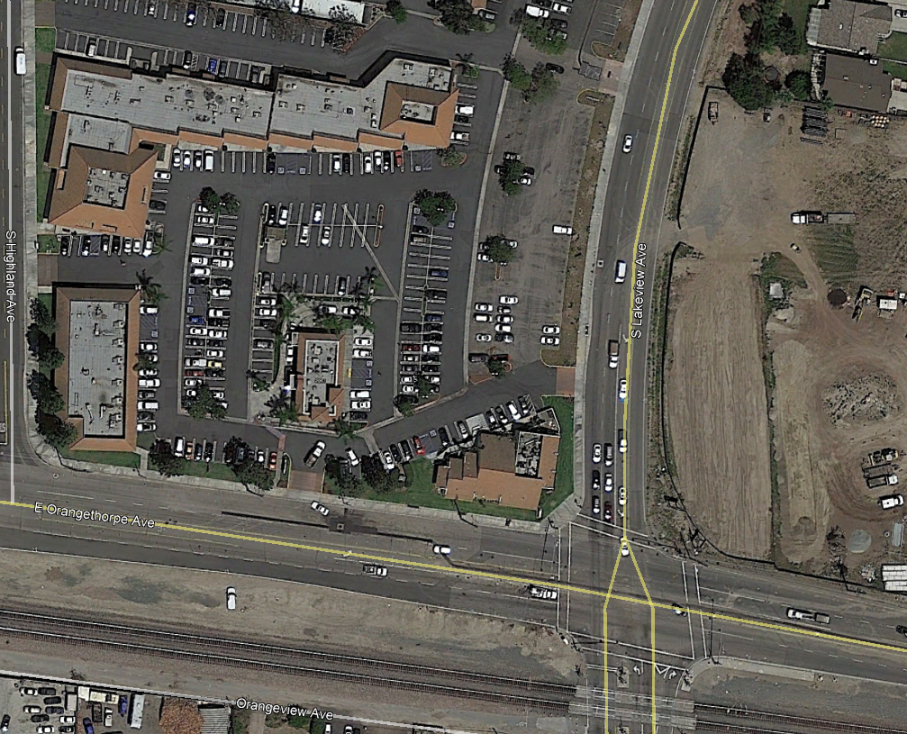
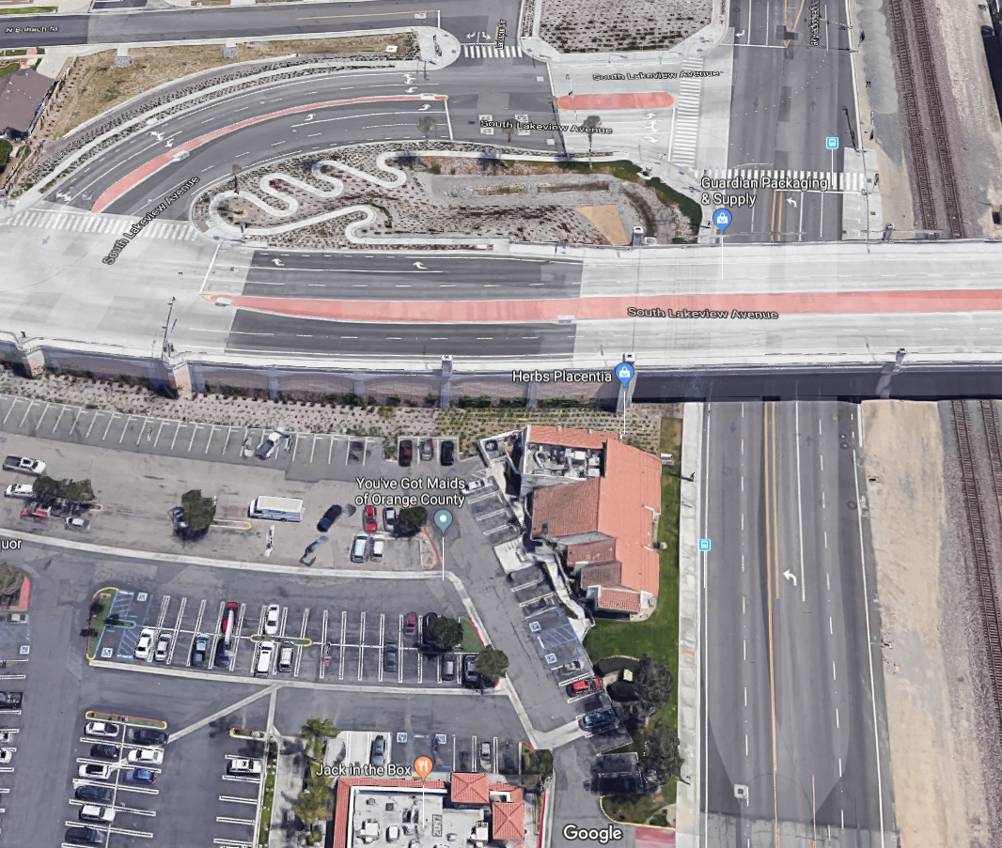
Regulations & Guidelines
PROJECT EXAMPLE 1

Slide 11
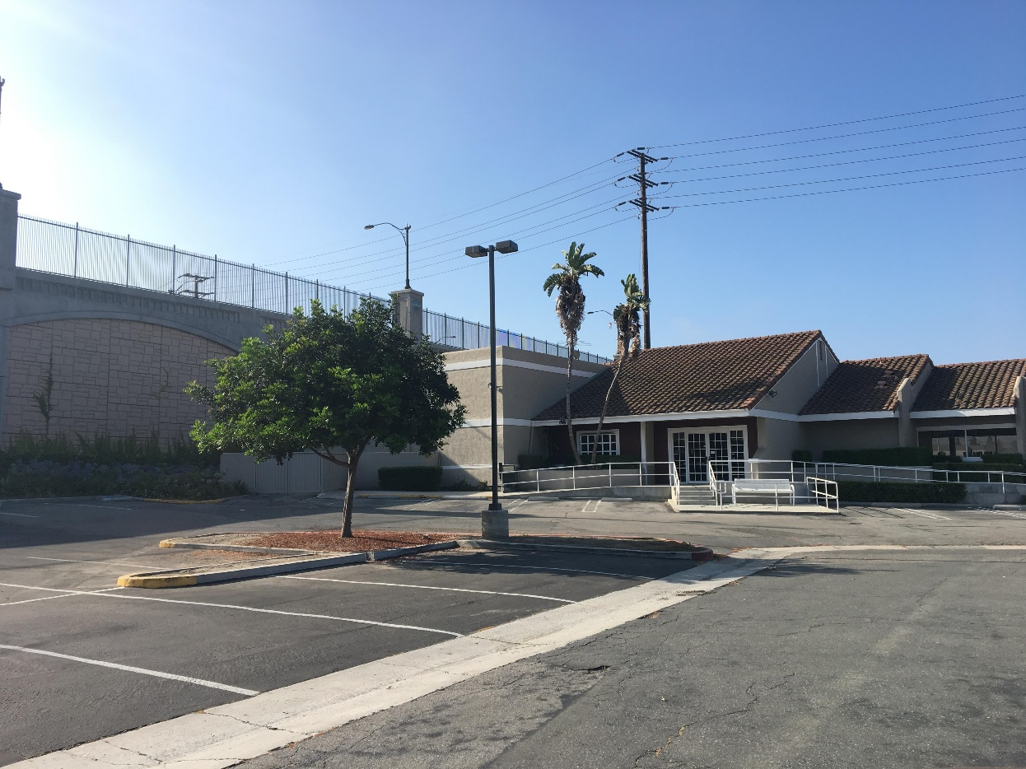
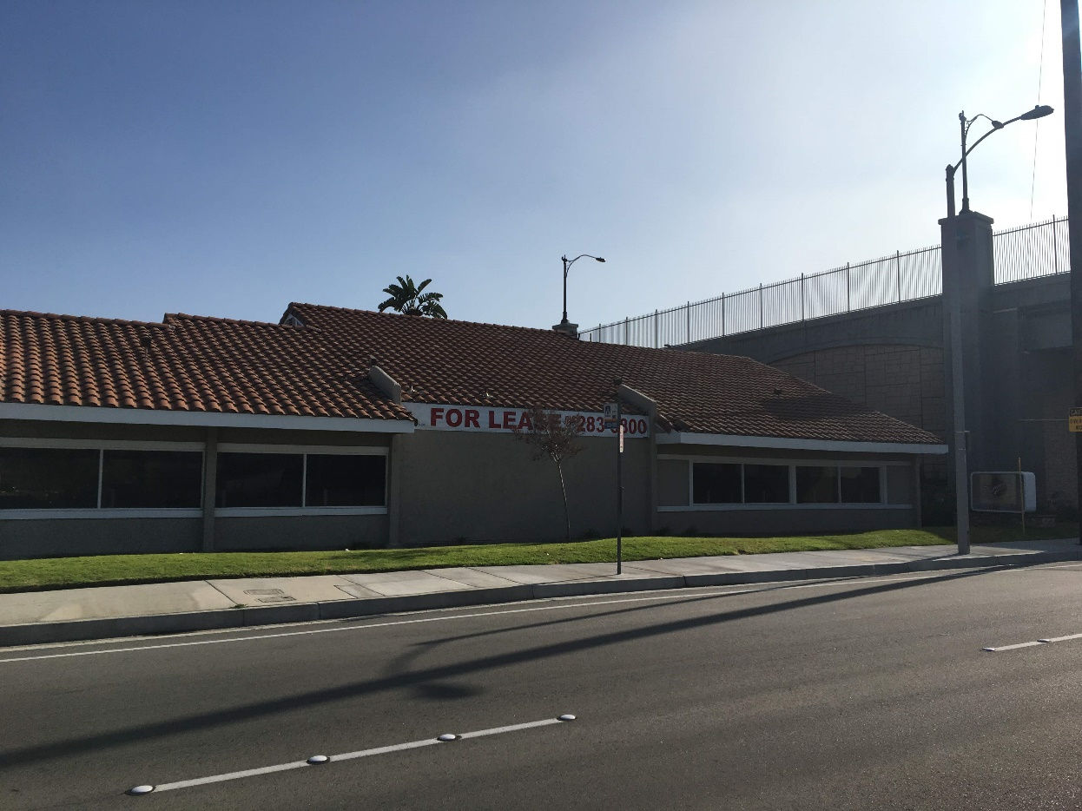
Regulations & Guidelines
PROJECT EXAMPLE 1

Slide 12
Regulations & Guidelines
TITLE 7 (EMINENT DOMAIN LAW) OF CCP
Other Relevant Sections
Compensation for Loss of Goodwill [§1263.510 - 1263.530]
Divided Interests [§1265.010 - 1265.420]
  Leases
    §1265.110: Where all the property subject to a lease is acquired for public use, the lease terminates.
    §1265.120: Except as provided in Section 1265.130, where part of the property subject to a lease is acquired for public use, the lease terminates as to the part taken and remains in force as to the remainder, and the rent reserved in the lease that is allocable to the part taken is extinguished.

Slide 13

Regulations & Guidelines
UNIFORM STANDARDS OF PROFESSIONAL APPRAISAL PRACTICE (USPAP)
What it is…
Sets standards for appraisers to develop and communicate their analyses, opinions, and conclusions
to intended users of their services in a manner that is meaningful and not misleading.
USPAP was created to promote and maintain a high level of public trust in appraisal practice by establishing requirements for appraisers.
Promulgated by the Appraisal Standards Board (ASB) and updated every two years (current edition is 2018-2019)

Slide 14
Regulations & Guidelines
UNIFORM STANDARDS OF PROFESSIONAL APPRAISAL PRACTICE (USPAP)
What Its Not
Not a law
Does not set specific methods appraisers should use
Does not establish who or which assignments must comply
When Does It Apply?
“An appraiser must comply with USPAP when either the service or the appraiser is required by law, regulation, or agreement with the client or intended user.” – USPAP Preamble

Slide 15
Regulations & Guidelines
UNIFORM STANDARDS OF PROFESSIONAL APPRAISAL
PRACTICE (USPAP)
What it includes
Definitions – Unique terminology specific to USPAP
Ethics Rule – Sets forth the requirements for integrity, impartiality, objectivity, independent judgement and
ethical conduct
Record Keeping Rule – Establishes the work file requirements for appraisal and appraisal review assignments
Competency Rule – Presents pre-assignment and assignment conditions for knowledge and experience
Scope of Work Rule – Presents obligations related to problem identification, research and analyses
Jurisdictional Exception Rule – Preserves the balance of USPAP if a portion is contrary to law or public policy
of a jurisdiction
Standards – Establishes the requirements for appraisal and appraisal review (Development) and the manner in which each is communicated (Reporting)
Advisory Opinions & FAQs

Slide 16
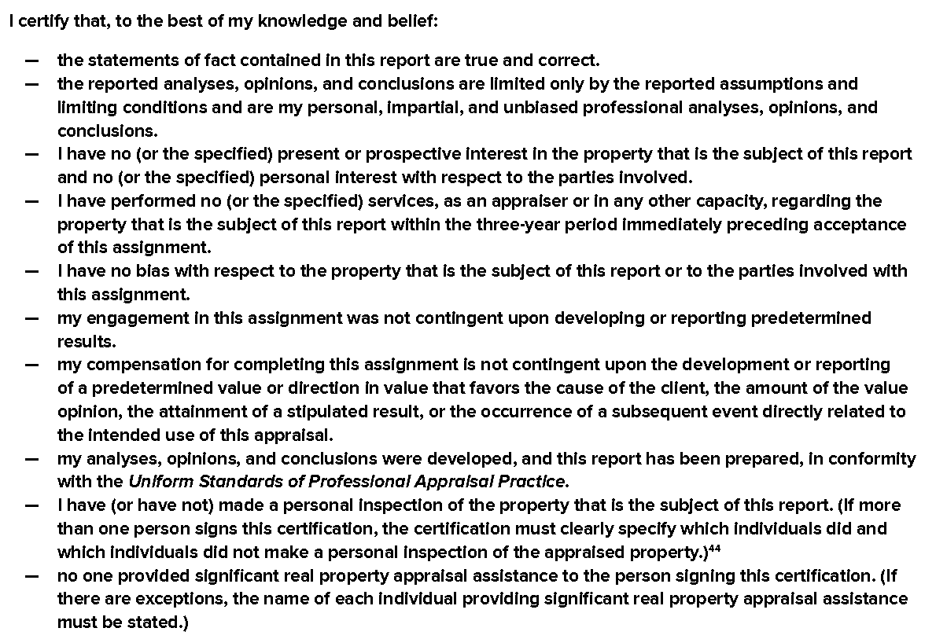
Regulations & Guidelines
UNIFORM STANDARDS OF PROFESSIONAL APPRAISAL PRACTICE (USPAP)

Slide 17
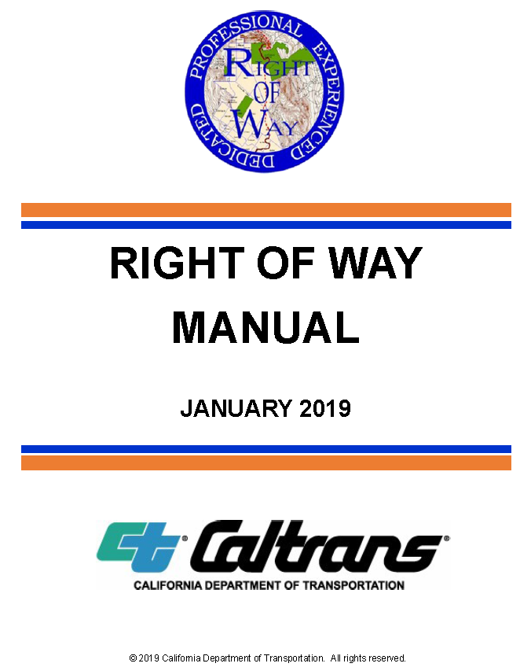
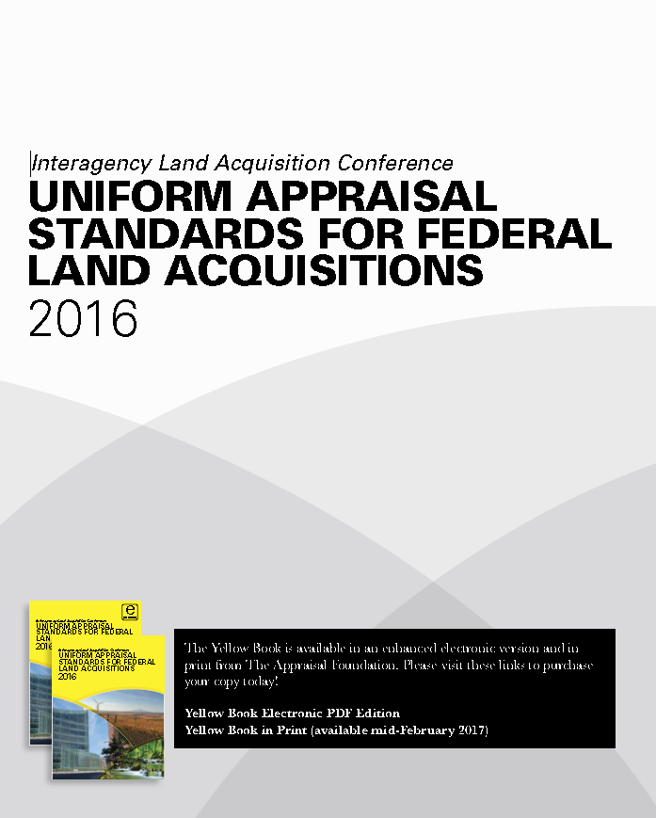
Regulations & Guidelines
OTHER…
Uniform Appraisal Standards for Federal Land Acquisitions (Yellow Book)
Caltrans Right of Way Manual (Chapter 7)

Slide 18
Appraisal Process
INITIAL STEPS
Discuss Project with the Client
Collect Property Information – Before Acquisition
  Ownership
  Sale History (USPAP requires analysis of past 3 years and current listings/options, Caltrans - 5 years, Federal - 10 years)
  Physical Features (Location, Size, Shape, Topography)
  Legal Restrictions (Zoning, General Plan, Assessments)
  Title Reports (Existing Easements and Other Encumbrances)
Perform Preliminary Market Analysis (Market Forces, Trends, Data)
Contact Property Owner for Inspection

Slide 19
Appraisal Process
INITIAL STEPS (CONTINUED)
Identify the Larger Parcel (3 Tests)
  Commonality of ownership;
  Physical contiguity; and,
  Common use and/or common highest and best use.

Slide 20
Appraisal Process
ANALYSIS – BEFORE ACQUISITION
Highest & Best Use
  “The reasonably probable use of property that results in the highest value. The four criteria that the highest and best use must meet are legal permissibility, physical possibility, financial feasibility, and maximum productivity.”
  Source: The Dictionary of Real Estate Appraisal, Sixth Edition. Chicago: Appraisal Institute, 2015.
As-Vacant and As-Improved

Slide 21
Appraisal Process
ANALYSIS STEPS – AFTER ACQUISITION
Review Taking Documents
  Maps
  Legal Descriptions
  Descriptions of Taking
    Fee Acquisition
    Other Property Rights
  Description of Easements
  Offer Letter and Appraisal Summary (Statement of Just Compensation)

Slide 22
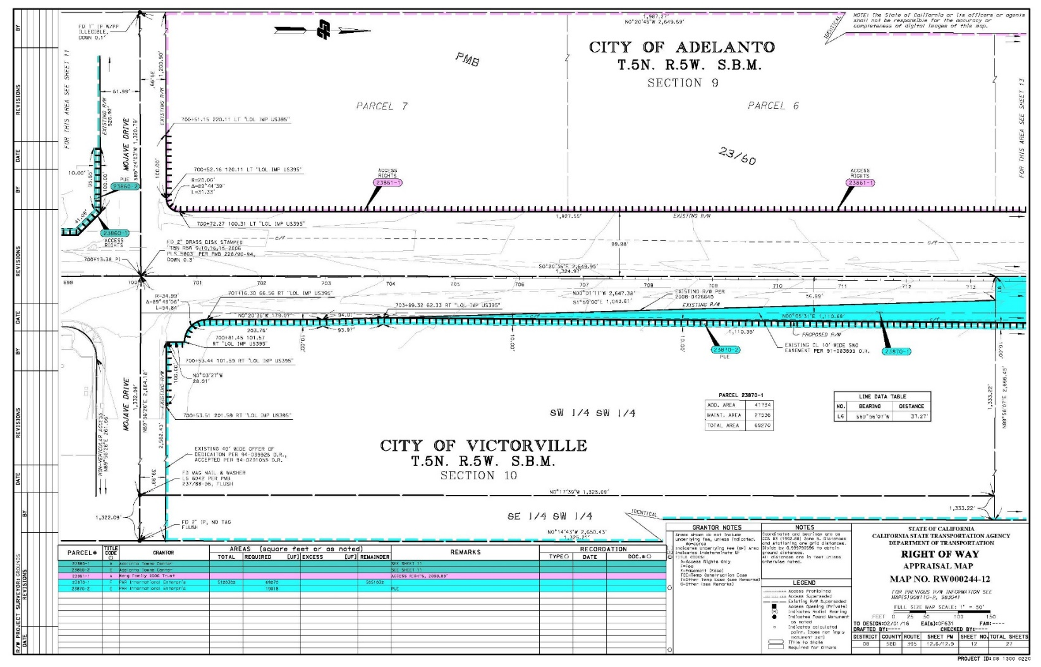
Example of Taking Map

Slide 23
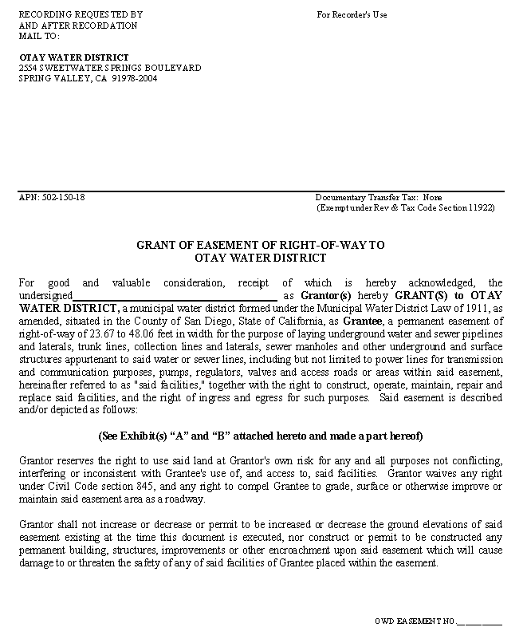
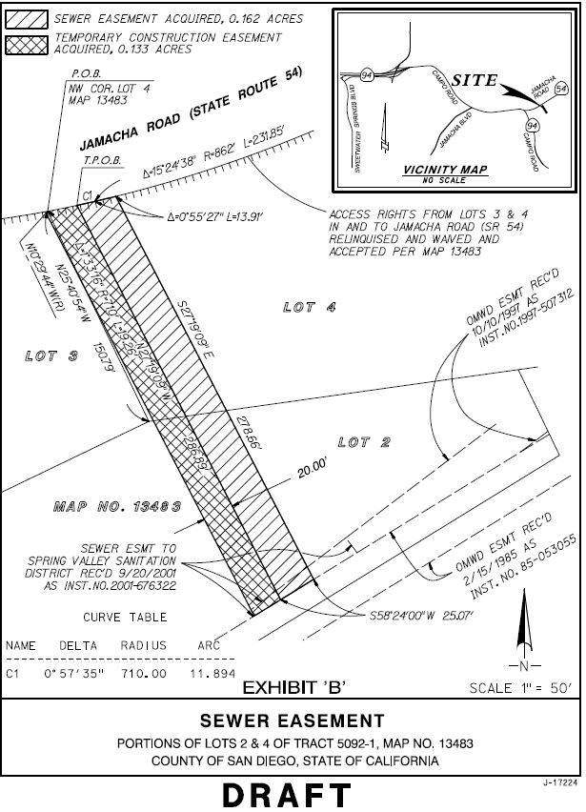
Example of Easement Description

Slide 24
Appraisal Process
ANALYSIS STEPS – AFTER ACQUISITION
Highest & Best Use
  Legal Permissibility
    Is the parcel still legally developable?
    Does it still have a sufficient number of parking spaces?
  Physical Possibility
    Does the new shape prohibit development?
    Is access, exposure and frontage the same?
  Financial Feasibility
    Did the project make construction more costly?
  Maximum Productivity

Slide 25
Appraisal Process
ANALYSIS STEPS – BEFORE AND
AFTER ACQUISITION
Data Collection
  Data Services (MLS, Costar, AIR, etc.)
  County Records
  Appraisal Files
  Market Participants
Verification
  Multiple Sources
  Confirm Transaction Not Project Influenced
  See Agency Requirements
Inspect Data (Google Earth is Great, but…)
Potential Data Set for After Condition

Slide 26
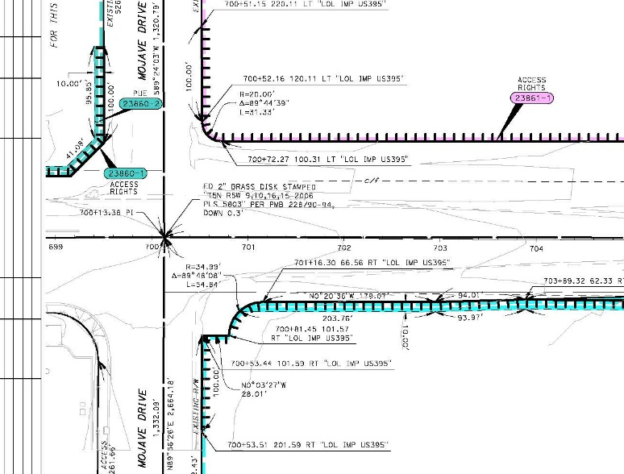
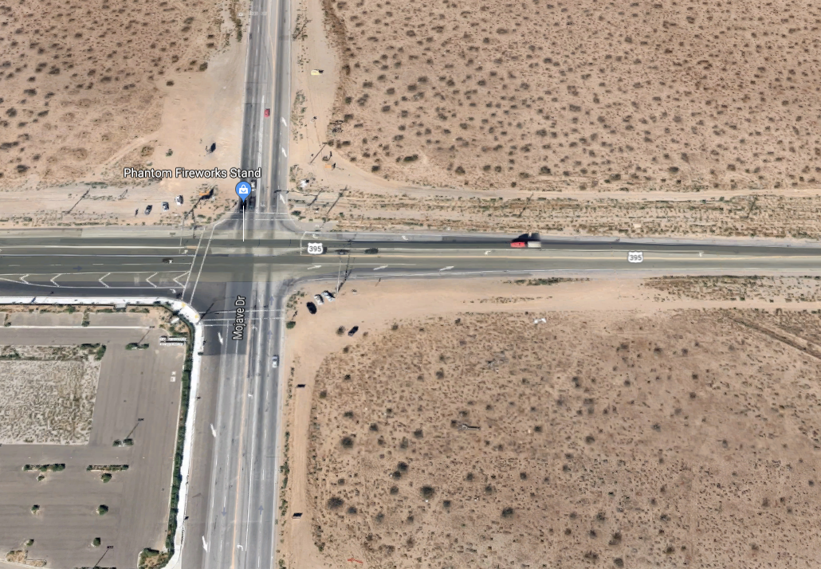
Appraisal Process
PROJECT EXAMPLE 2

Slide 27
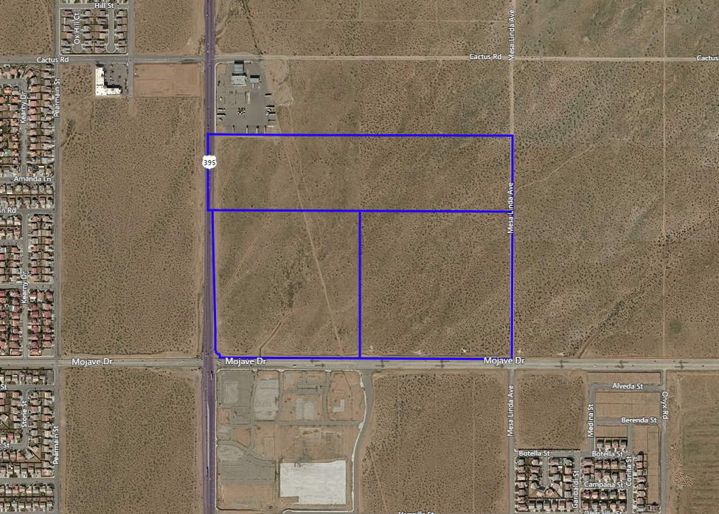
Appraisal Process
PROJECT EXAMPLE 2
Larger Parcel
100+ Acres
Area of Taking

Slide 28
Valuation Methodology
WHAT METHOD IS USED TO VALUE A TAKING?
  Before and After Analysis
  Application Depends on the Project
    Highest and Best Use
    Acquiring Land and/or Improvements or Other Rights
    Entire Property or Partial Acquisition
    Permanent or Temporary Easements
  Variations (Ex: TCE)

Slide 29
Valuation Methodology
BEFORE AND AFTER METHOD
  Value the Larger Parcel (via Sales Comparison, Income Approach, Cost Approach)
  Value the permanent parts taken (can include land, buildings, other rights) as part of the whole.
  Calculate the value of the remainder as part of the whole.
  Value the remainder property in the after condition.
  Compare the value of the remainder as part of the whole with the value of the remainder in the after condition to calculate severance damages, if any.
  Project benefits (if any) are considered and net severance damages are calculated.
  The temporary loss of use of the property during construction is calculated (if any).
  A final estimate of the fair market value of the parts taken.

Slide 30
Valuation Methodology
CALCULATION EXAMPLE 1

Slide 31
Valuation Methodology
CALCULATION EXAMPLE 2

Slide 32
Valuation Methodology
CALCULATION EXAMPLE 3

Slide 33
Valuation Methodology
VALUATION OF EASEMENTS
  What is an Easement?
    An easement is an interest in real property that transfers use, but not ownership, of a portion of an owner’s property. - The Appraisal of Real Estate, 14th Edition
  Permanent (Ex: Utility) and Temporary (Ex: Construction)
  Area Impacted:
    Surface
    Sub-surface
    Above-ground
    Combination
Types:
Avigation
Flowage
Conservation
View
Road
Transmission Line
Levee
Clearance
Sway
Etc…

Slide 34
Valuation Methodology
VALUATION OF EASEMENTS
  Valuation of Permanent Acquisitions
    Direct Comparison
    Percentage of Fee Value
      Quantitative Analysis (Ex: Paired Sales)
      Qualitative Analysis (Ex: Opinion)

Slide 35
Valuation Methodology
VALUATION OF EASEMENTS
  Temporary Acquisitions (Ex: Temporary Construction Easement)
  Generally acquired in conjunction with a permanent acquisition and often abuts the boundaries of the permanent acquisition
  Is on a temporary basis and fee interest reverts back to the owner at the end of the easement
  Just Compensation based on market rent for area
  Valuation Methodology
    Direct Comparison (Lease Comparables)
    Land Rent Factor

Slide 36
Valuation Methodology
TEMPORARY ACQUISITIONS
(EX: TEMPORARY CONSTRUCTION EASEMENT)
Land Rent Factor
  Value = Income / Rate
  Restructuring the formula to solve for income results in the following:
  Income = Value X Rate

Slide 37
Valuation Methodology
TEMPORARY ACQUISITIONS
(EX: TEMPORARY CONSTRUCTION EASEMENT)
Land Rent Factor Considerations
  Lease Structure (Triple Net, Gross)
  Real Estate Taxes
  Escalations
  Term Length

Slide 38
Areas of Concern
Non-Conforming Use Due to Taking
Impact to the Going-Concern

Slide 39
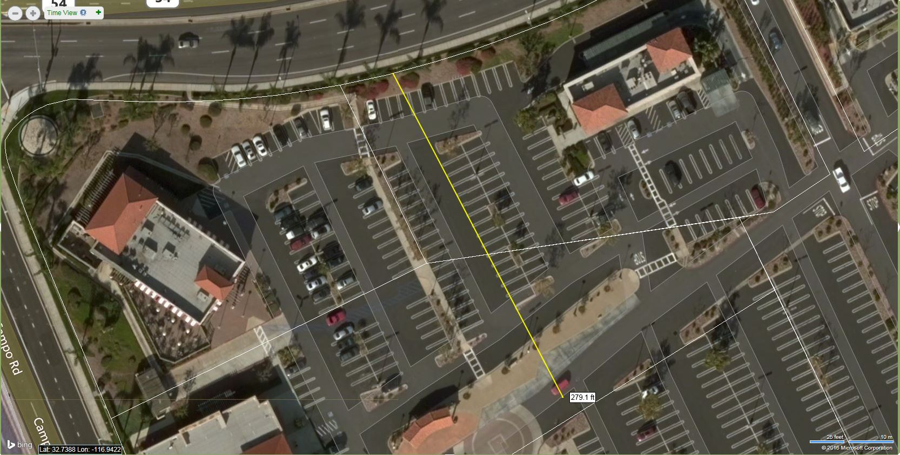
Areas of Concern
PROJECT EXAMPLE 3

Slide 40
Areas of Concern
Non-Conforming Use Due to Taking
Impact to the Going-Concern
Project Impacts Result in Full Taking

Slide 41
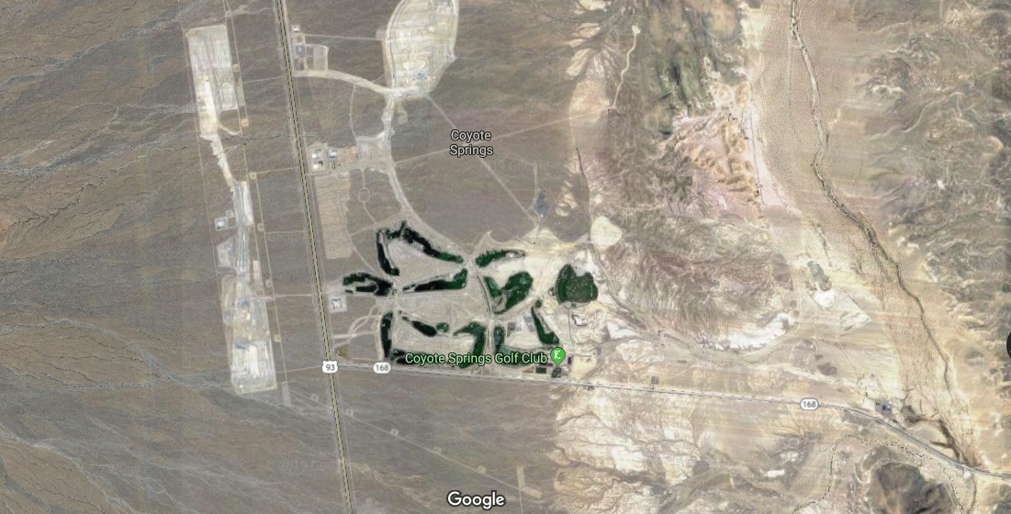
Valuation Methodology
PROJECT EXAMPLE 4

Slide 42
Areas of Concern
Non-Conforming Use Due to Taking
Impact to the Going-Concern
Project Impacts Result in Full Taking
Zones of Value

Slide 43
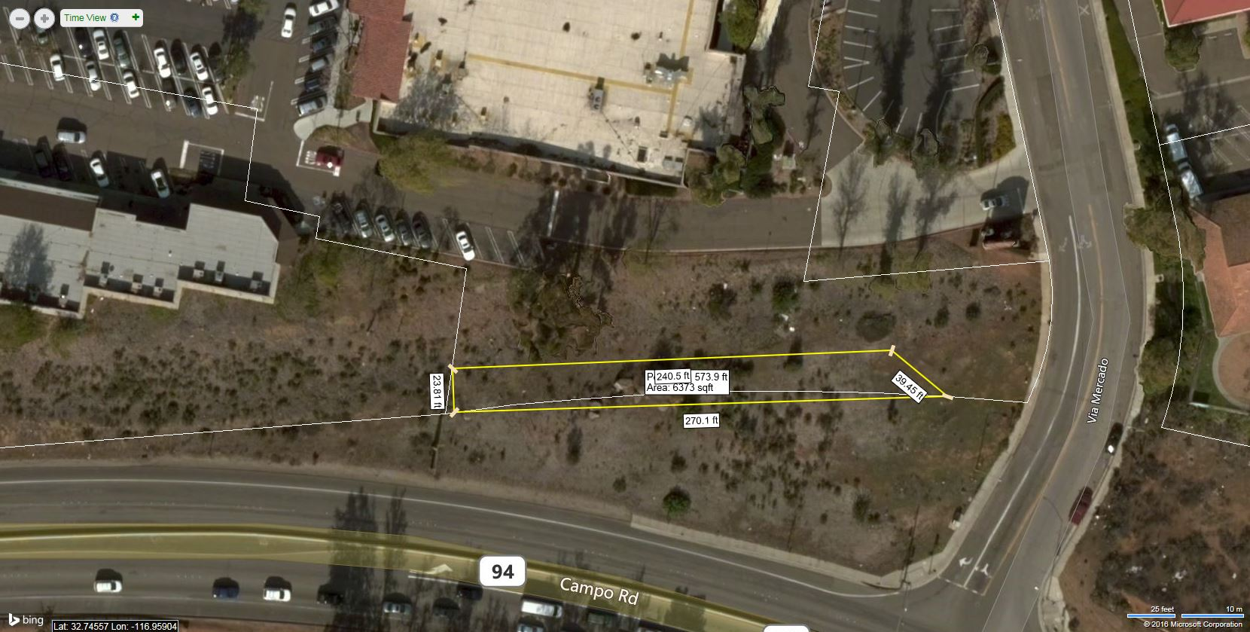
Valuation Methodology
PROJECT EXAMPLE 5

Slide 44
Areas of Concern
Non-Conforming Use Due to Project
Impact to the Going-Concern
Project Impacts Result in Full Taking
Zones of Value
Valuing Land Only on Improved Property
Consistent Use
Unsubstantiated Highest and Best Use

Slide 45
Questions?

Slide 46


