Slide 1
The public land survey system
The World’s Biggest Subdivision Project
Jeremy Evans, PLS

Slide 2
PLSS

Slide 3
PLSS Extents
1.5 Billion Acre Subdivision Project

Slide 4
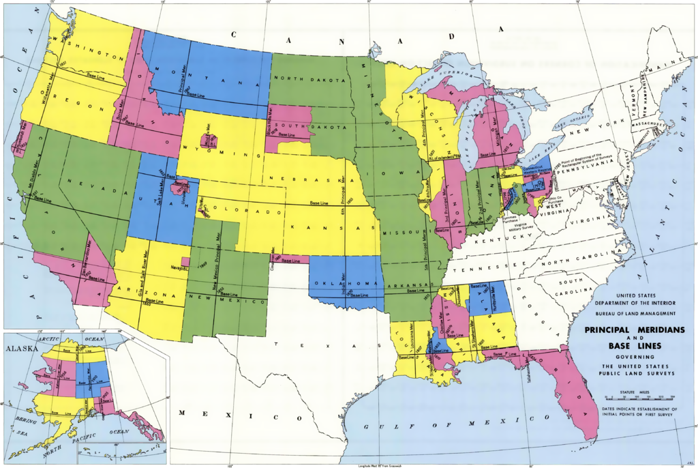
Question of the day
Where is the Southeast Quarter of the Southeast Quarter of Section 19, Township 5 South, Range 10 West, San Bernardino Meridian*

Slide 5
History
After Revolutionary War, United States was land rich, but financially poor
U.S. extended from east coast to Mississippi River and Great Lakes to Gulf of Mexico
Needed to sell newly acquired land into private ownership to secure the land, raise money and levy taxes
Before land could be sold, needed to be surveyed
Public Land Survey System (PLSS) was originally proposed by Thomas Jefferson
Rectangular system of surveys
Property easily located as compared to “Metes and Bounds” surveys of eastern states
“Genius in its Simplicity”

Slide 6
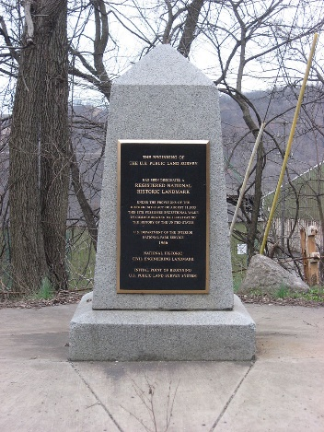
History
Land Ordinance of 1785
Established the standardized system of subdividing federal land for purchase by settlers
Office of the Surveyor General created
First Surveys conducted in Ohio
Seven Ranges
Beginning Point in Ohio where Ohio, Pennsylvania, and Virginia (now West Virginia) meet
System has been “tweaked” to current method of subdivision
Northwest Ordinance of 1787
“Filled in some political blanks” from 1785 ordinance

Slide 7
Initial Points

Slide 8
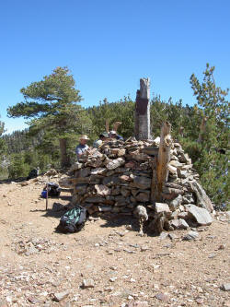
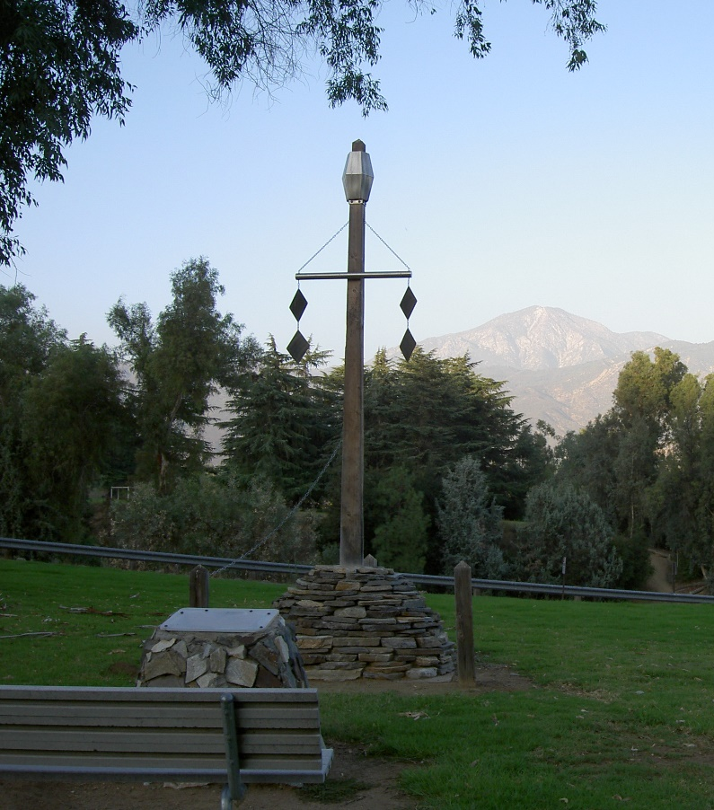
Initial points
Original San Bernardino Initial Point (1852 – Henry Washington)

Slide 9
Principal Meridians and baselines

Slide 10
Principal meridians and baselines
Principal Meridians run “True” North and South from Initial Point
Baselines run “True” East and West from Initial Point
Guide Meridians and Standard Parallels “True Up” the Survey at regular intervals
Quadrangles
Monuments set every half mile along all lines

Slide 11
townships
Standard Township is 6 miles on each side
Township 3 South, Range 3 West, San Bernardino Meridian

Slide 12
sections
Standard Section is 1 mile on each side
“Boustrophedonic Pattern”
Section 8, Township 3 South, Range 3 West, San Bernardino Meridian

Slide 13
Aliquot parts of a section
Northeast Quarter, Southeast Quarter, Section 8, Township 3 South, Range 3 West, San Bernardino Meridian
Sections were protracted
No monuments set on interior lines within Section

Slide 14
Question of the day

Slide 15
Question of the day
*Actually not part of the Federal PLSS.
Rancho Las Bolsas

Slide 16
Questions and answers

