Slide 1
Plans and Specs
Coordination with Right of Way and Utilities
Presented by
Uyenly Bui, Senior Civil Engineer, City of Irvine
Darrell Hartman, Senior Civil Engineer, City of Irvine
IRWA Summer Refresh Seminar
July 16, 2019

Slide 2
PROJECT PHASES INVOLVING RIGHT OF WAY & UTILITIES
Planning/Preliminary
Final Design
Construction

Slide 3
PLANNING/PRELIMINARY ENGINEERING
Capital Improvement Project (CIP) development from initial concept to a complete scope of work
Typical “Scope of Services”:
Research/Review
Aerial Topographic Mapping
Utilities Research & Coordination
Environmental Compliance
Technical Studies
Preliminary Design Plans
Preliminary Quantities and Cost Estimates
Identify Right-of-Way Engineering (ROW) Impacts & Costs
Meetings, Presentations and Exhibits
Notes:
The City of Irvine often conduct a preliminary engineering phase on most projects. We invest the time, the staff, and the resources to do our diligence to flush out all issues early that can potentially impact the project. The preliminary engineering phase acts a guidance to pave the way and sets itinerary for the next two phases.

Slide 4
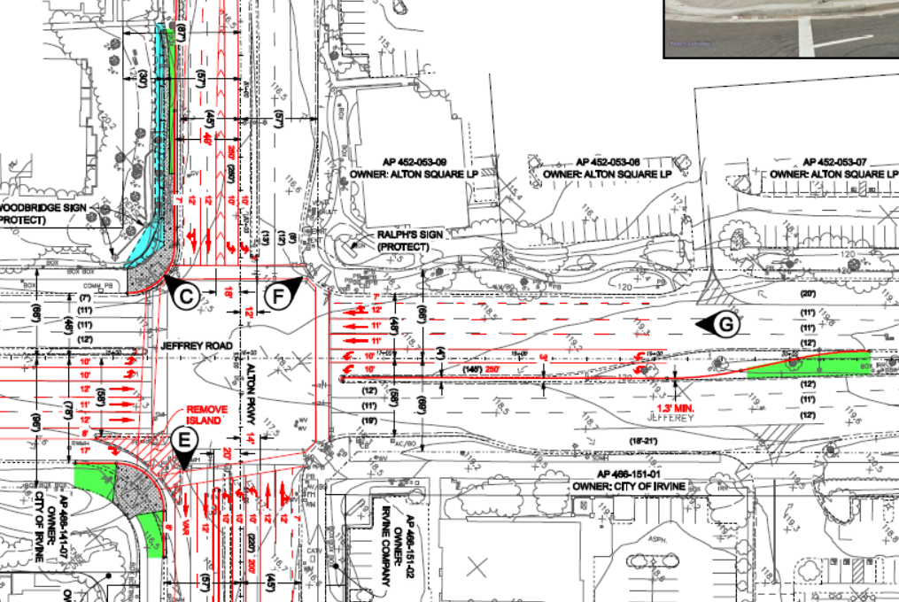
PLANNING/PRELIMINARY
Identifies stakeholders and project constraints, then “build” alternatives are developed and compared with the “no-build alternative”; concludes with a “preferred” build alternative

Slide 5
PLANNING/PRELIMINARY
Meetings/Coordination
Utilities
Stakeholders (e.g. property owners, Homeowner’s Associations)
Jurisdictional agencies
Importance:
Project/no project
Impact schedule
Legal issues
Monetary costs
Effort to find solutions

Slide 6
PLANNING/PRELIMINARY
Environmental Compliance
California Environmental Quality Act (CEQA)
National Environmental Policy Act (NEPA) – Federally-funded; federal land
Technical Studies & Findings – traffic impacts, water quality, biological, noise, geotechnical, air quality, drainage, initial site assessment

Slide 7
PLANNING/PRELIMINARY
Phase l/ll studies – Reports prepared for properties that identifies potential or existing environmental contamination liabilities; completed for all parcels involved for appraisal to assess the value of properties
Phase I – Initial Site Assessment (ISA) report; site description, historical use, search of environmental database, site reconnaissance
Phase II – Soil samples, soil borings; groundwater tests; only done if recommended by Phase I

Slide 8
PLANNING/PRELIMINARY
Right of Way (ROW) – Estimate ROW cost for each alternative

Slide 9
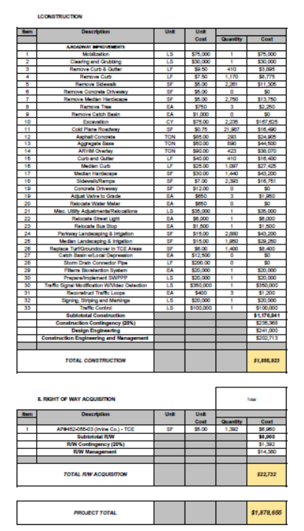
PLANNING/PRELIMINARY
Prepare a preliminary cost estimate to plan a project budget. Identify required studies, jurisdictional regulations, right of way requirements, utility impacts, permits, stakeholders, end users.
Prepare Project Report – Guiding document with next steps; contains preliminary design plans, supporting technical studies, ROW impacts, cost estimate, public involvement, funding sources, and concludes with a justification for the decision

Slide 10
FINAL DESIGN
Final construction documents are developed using preliminary information generated during the Preliminary Engineering phase.
Typical “Scope of Services”:
Base/Preliminary Data Review
Permits
Utilities Identification, Research, Coordination and Notices
Plans
Reports, Studies and Calculations
Environmental and Water Quality Compliance
Special Provisions
Quantities and Cost Estimates
Critical Path Method (CPM) Schedule
Right-of-Way Engineering (ROW) and Legal Descriptions
Meetings, Presentations and Exhibits

Slide 11
ROW NEEDS
Initial information necessary to determine Right of Way needs:
Base map
Topographic survey
Existing right of way information
Proposed improvements/geometrics
Utility relocations/modifications
Right of Way Determination – Additional right of way needs are determined by comparing existing right of way information and proposed improvements. Care must be taken to allow for access and construction of the improvements as well as the improvements themselves.

Slide 12
FINAL DESIGN SCHEDULE
65% Design:
ROW activity may begin
For tight project schedule - Enables the ROW to be secured in time to meet project schedule
However, may need to go back and acquire additional ROW if any design issues cause a change in ROW requirements as we approach 85% to 100% design
85% to 100% Design:
Ideally ROW Activity should begin at 85-100%
The changes to ROW requirements will be minimal
However, project schedule may suffer due to a later start date for right of way activities

Slide 13
ROW ACTIVITIES
Activities:
Title reports – Property dimensions and encumbrances: liens, easements, etc.
Preparation of ROW maps and legal descriptions by the City’s design consultant
Preparation of the Appraisal – prepared by the City’s appraisal consultant
Preparation of the offer and negotiations for the property by the City

Slide 14
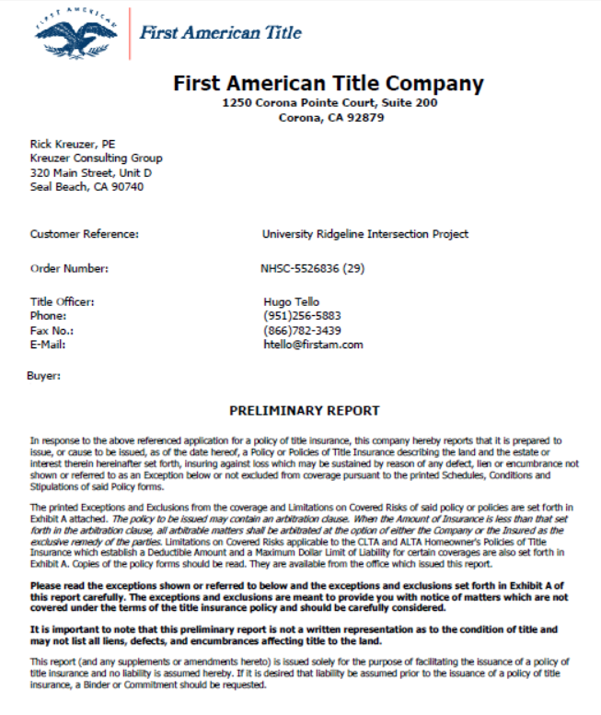
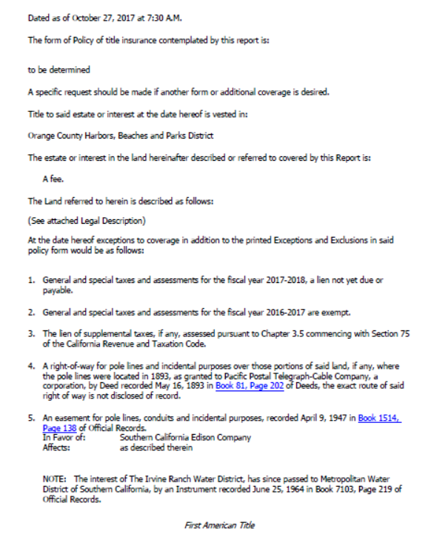
TITLE REPORT
Title reports – Details liens, easements, etc. on the properties

Slide 15
ROW EXHIBIT (COMPREHENSIVE)

Slide 16
ROW EXHIBIT (PROPERTY SPECIFIC)

Slide 17
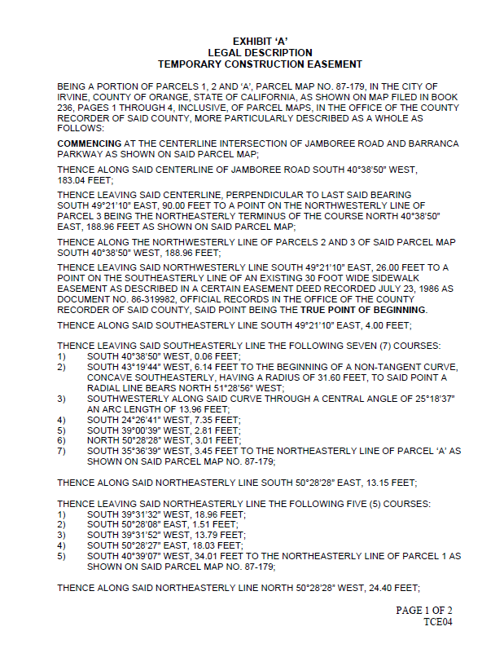
PLAT MAPS & LEGAL DESCRIPTIONS

Slide 18
SECURE RIGHT OF WAY
Fee
Easement
Lease

Slide 19
FEE vs. EASEMENT
Fee – owner retains responsibility for cleanup of all contamination underneath property
Easement – Agency not responsible for contamination below the land

Slide 20
EASEMENTS
Typical easements secured by a local agency include:
Roadway Easements
Landscape Easements
Sidewalk Easements
Drainage Easements
Non-standard easements may include:
Wall or Footing Easements
Aerial Easements
General deed language will state “…a perpetual easement for public street and utility purposes…”
More specific deed language will state “…a perpetual easement to plant, maintain, replace or remove landscaping…”

Slide 21
LEASE
Lease for use of a property for a period of time; renewable
(e.g. City of Irvine leases Southern California Edison’s property for use as a trail)
Walnut Trail

Slide 22
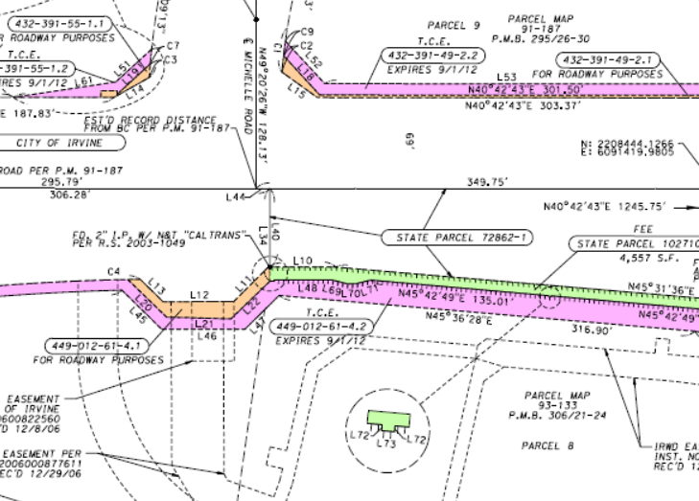
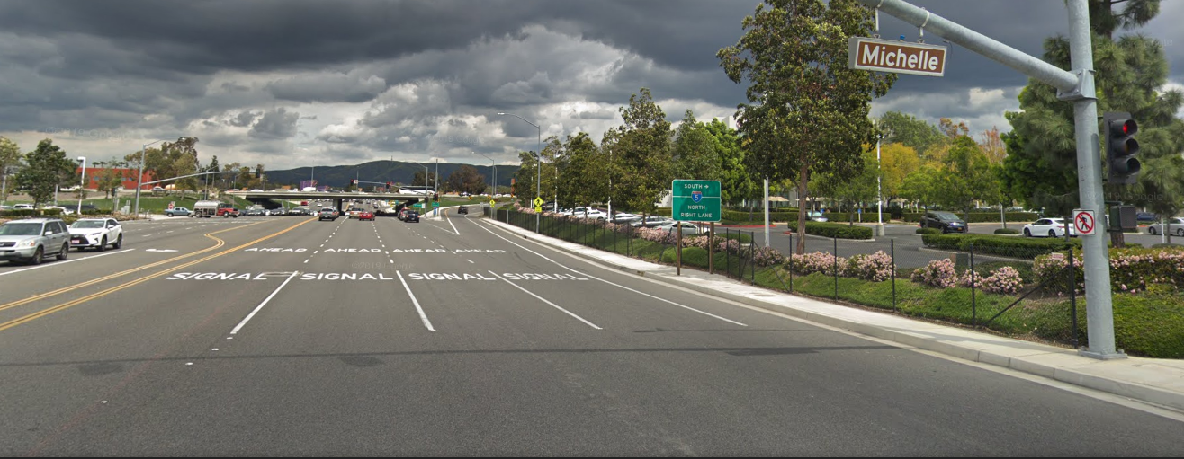
FEE ACQUISITION
Fee Acquisition – recorded deed with the legal descriptions and plat map describing acquired property, transferring to the new owner’s name
Jamboree Road/I-5 Interchange

Slide 23
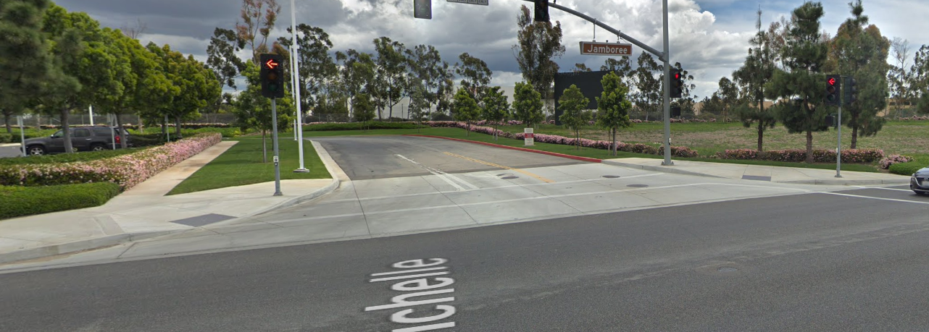
PERMANENT EASEMENT
Permanent Easement – recorded document that new owner has a right for use an identified area for a specific purpose, described in a legal description and plat map

Slide 24
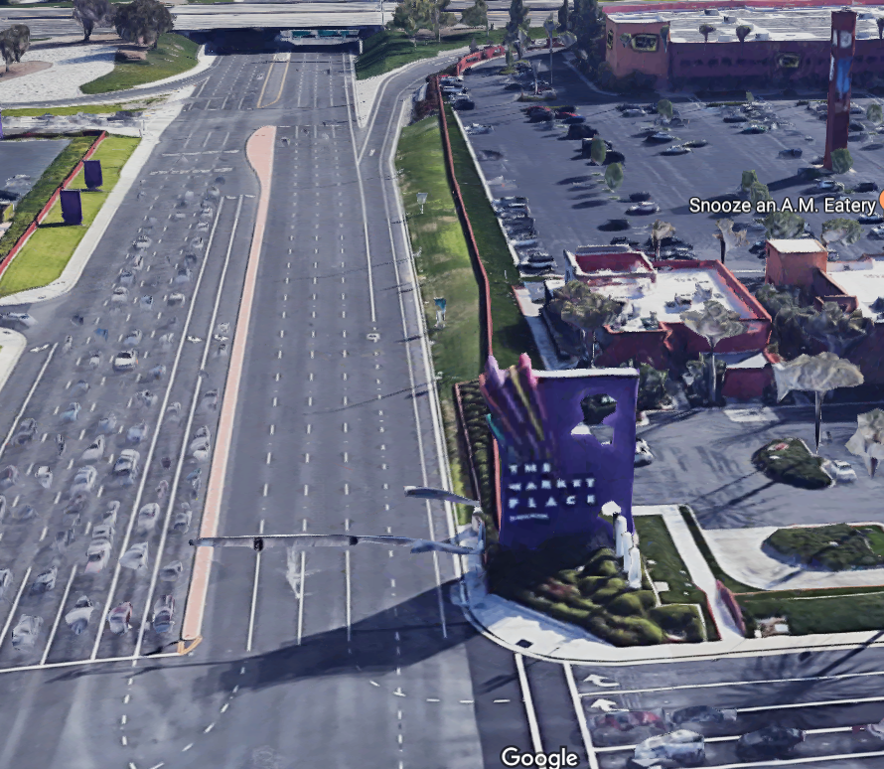
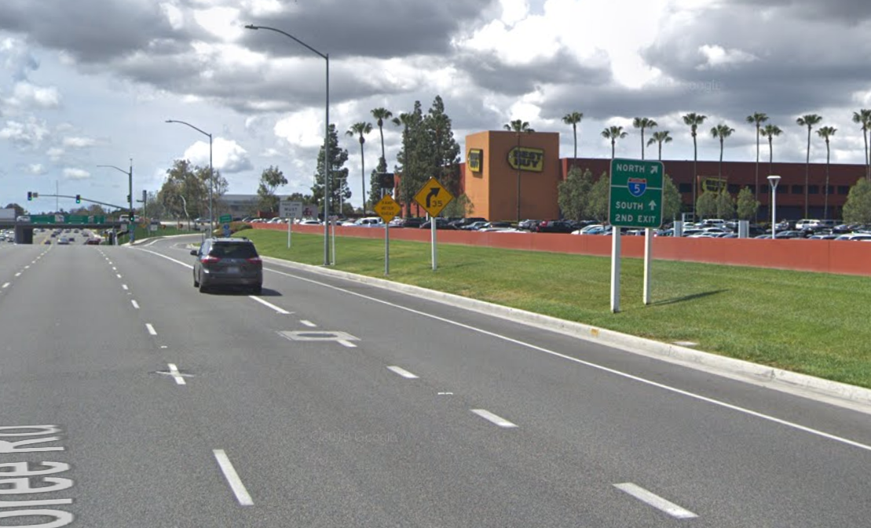
TEMPORARY CONSTRUCTION EASEMENT
Temporary construction easement (TCE) – Compensated, non-recorded document granting the right to enter a specific area of a property for construction activities; may mention work hours, timeframe before TCE expires, advanced notification, re-establish property to existing condition when done.
TCE for roadway improvements, TCE for mitigation areas

Slide 25
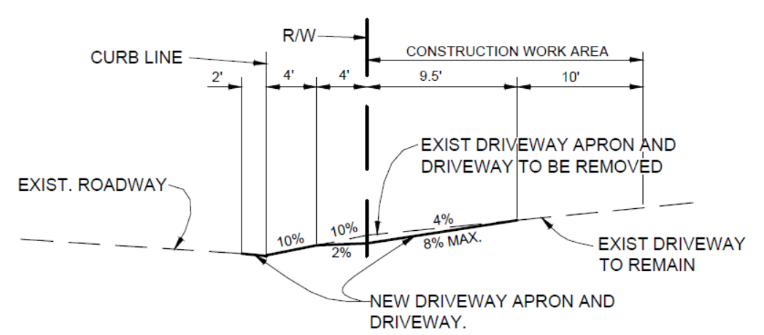
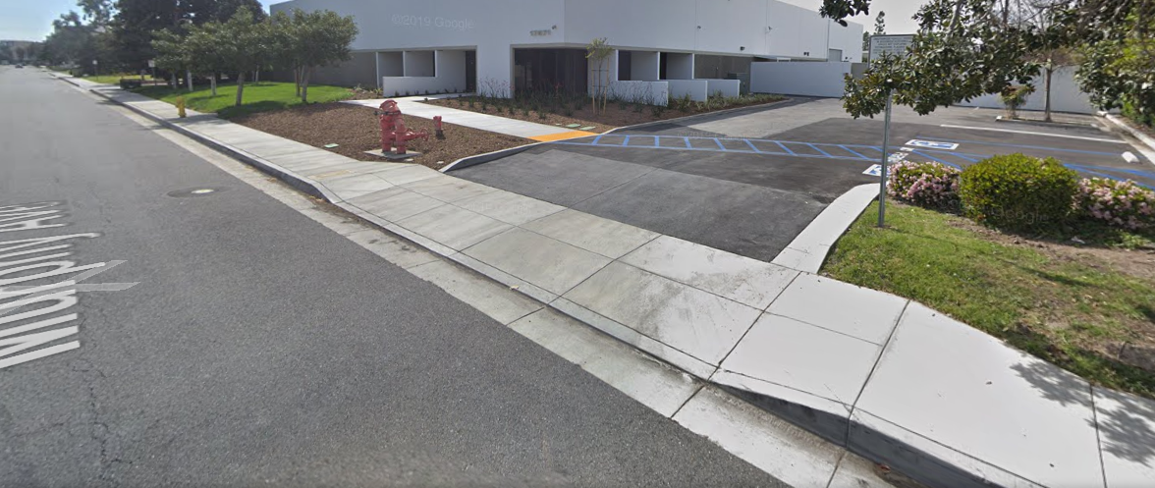
RIGHT OF ENTRY / PERMIT TO ENTER & CONSTRUCT
Permit to Enter and Construct – Non-recorded permit used when project improvement is for the benefit of the property owner; no condemnation.

Slide 26
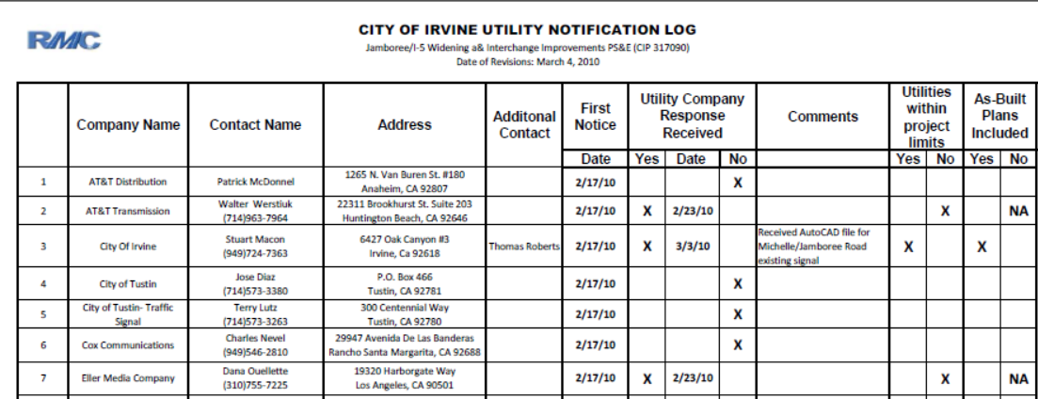
UTILITIES COORDINATION
Contact Dig-A-Lert for listing of utilities in project vicinity
Utility Notices:
Preliminary (request for utility maps); set up utility log sheet

Slide 27
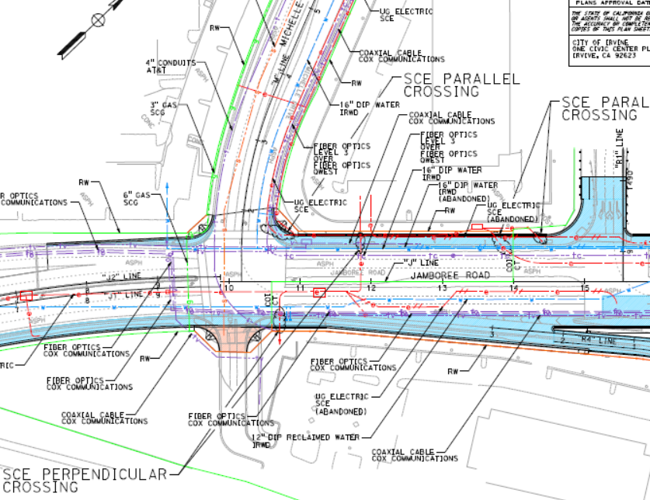
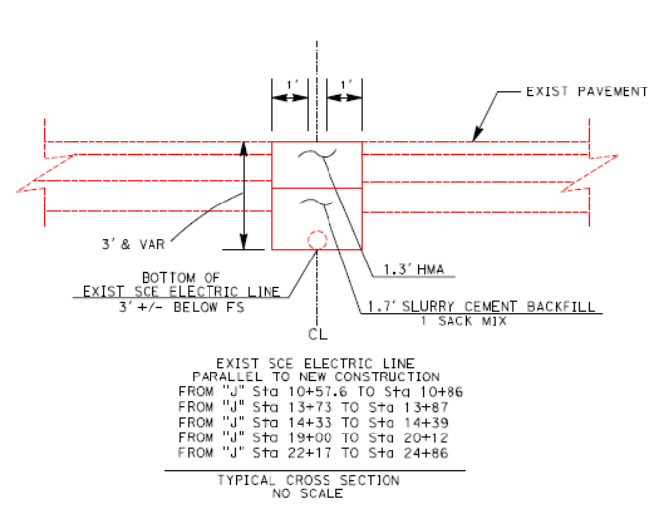
UTILITIES COORDINATION
Second Notice – Review plans for accuracy of utilities shown; determine prior rights; pothole crossings to determine if any conflicts

Slide 28
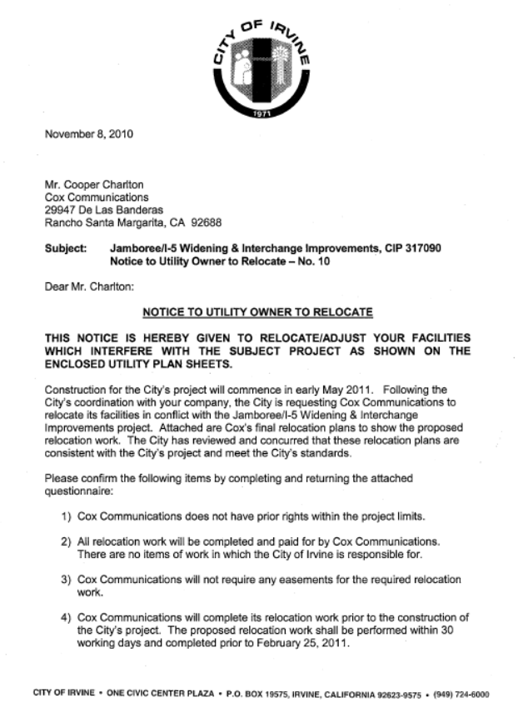
UTILITIES COORDINATION
Third Notice (Final) – Notice to Relocate

Slide 29
FEDERAL FUNDING/STATE RIGHT OF WAY
If project is federally-funded or on State’s property, a Right of Way Certification is required (Caltrans Right of Way Manual, Chapter 14). General requirements include:
Final Project Plans and Specifications
Caltrans Right of Way Certification
Project Engineer’s Utility Certification
Utility “Notice to Owners”
Project Environmental Documents
Right of Way Agreements

Slide 30
CONSTRUCTION
Project is awarded to Contractor who to builds the improvements and delivers a completed facility based on final construction documents.
Stake ROW/TCE lines in the field and to make the contractor aware of the construction area he has to work within.
Include property owner provisions in the project Special Provisions.
Include utility durations in the project Special Provisions.

Slide 31
SPECIFIC PROPERTY REQUIREMENTS
Contractor shall comply with specific property requirements, included in the contract special provisions. If applicable, include the following information:
Property address
Contact information
Special notice requirements
Special access requirements
Durations/timelines
Modified insurance limits
Specific instructions included in right of way agreements

Slide 32
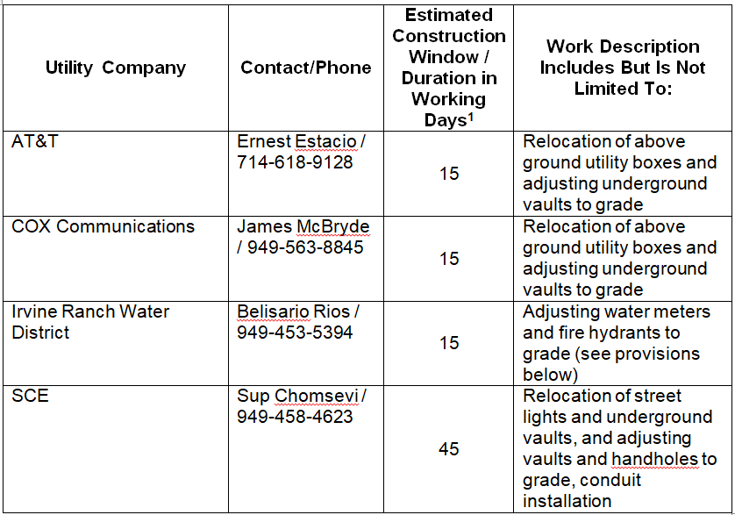
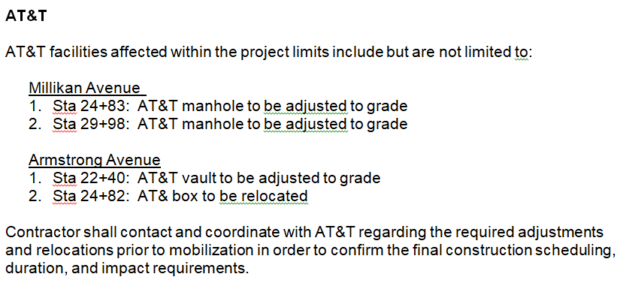
SPECIFIC UTILITY REQUIREMENTS
Contractor shall comply with specific utility requirements, included in the contract special provisions. If applicable, include Utility Contact Table and additional utility specific information
Utility Contact Table
Utility Specific Information

Slide 33
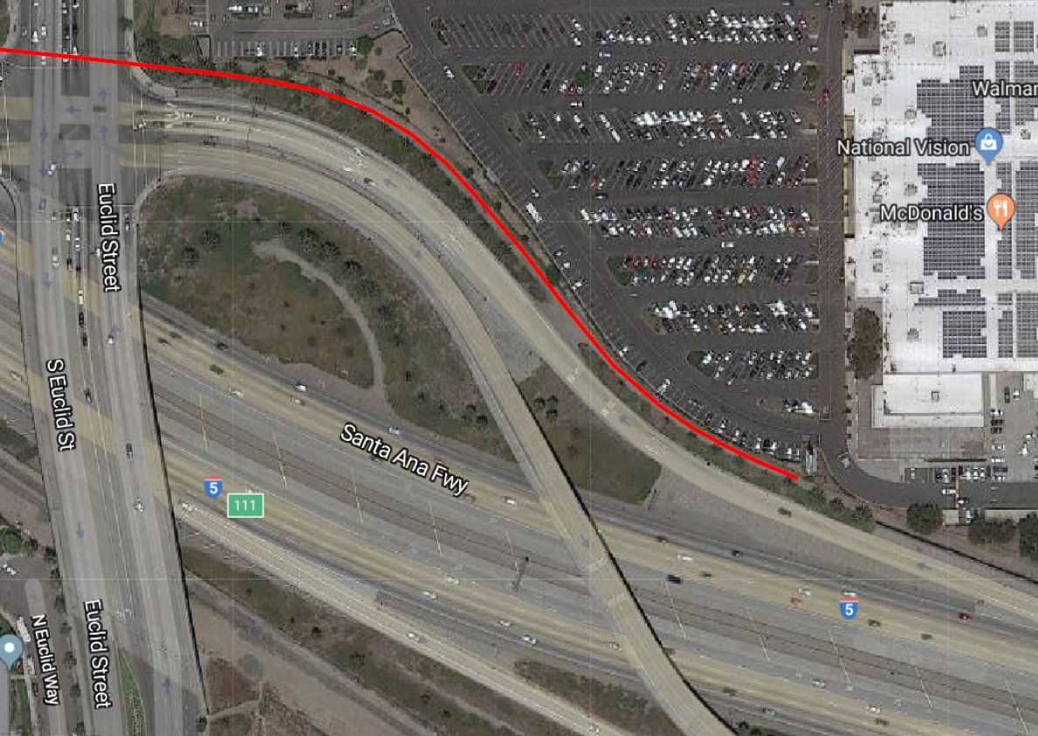
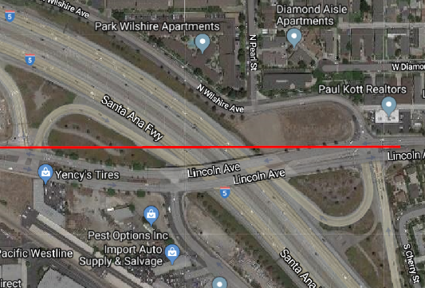
RIGHT OF WAY CONSTRUCTION IMPACTS
Caltrans I-5 Segment “C”
RCB at Euclid Plaza
Lincoln OC Utilities

Slide 34
Plans and Specs
Coordination with Right of Way and Utilities
Questions?
IRWA Summer Refresh Seminar
July 16, 2019

