Slide 1
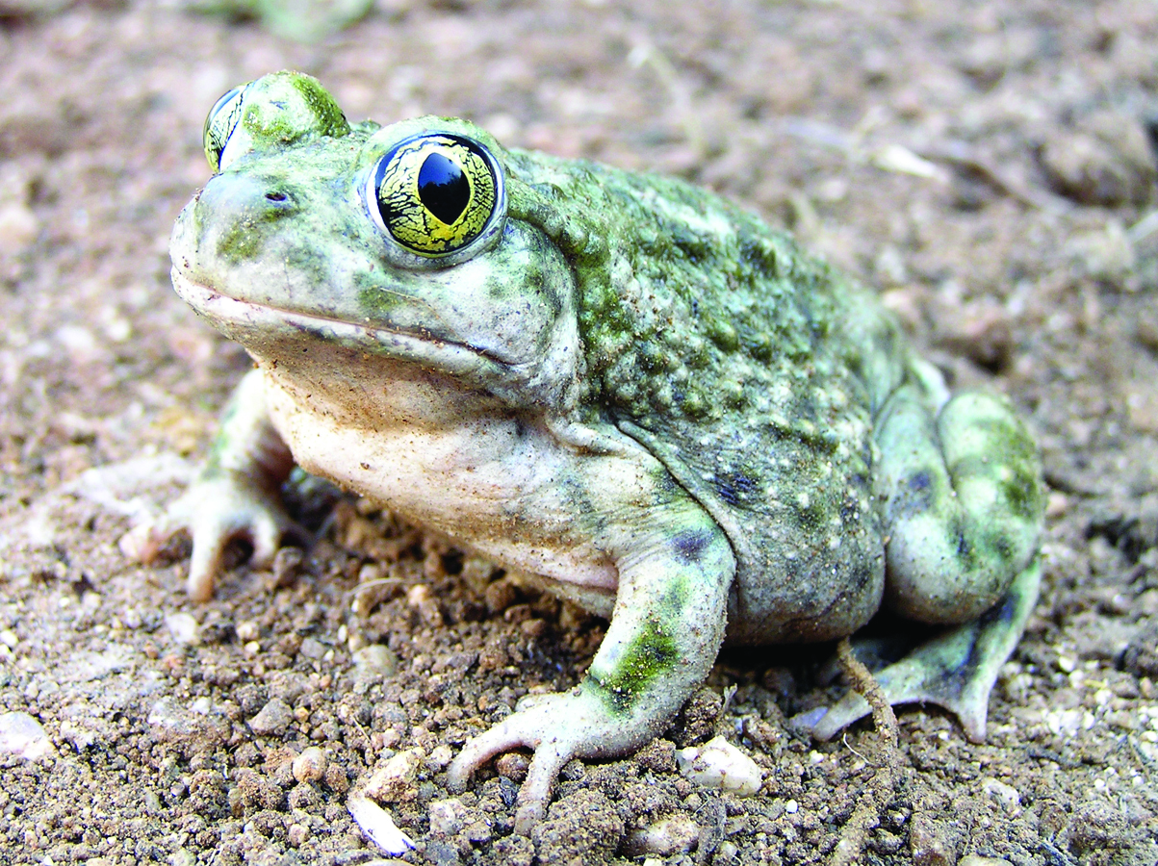
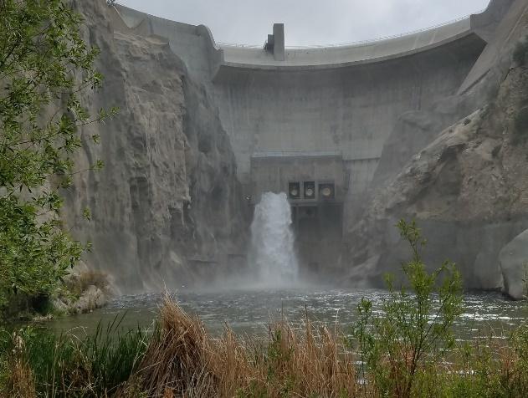

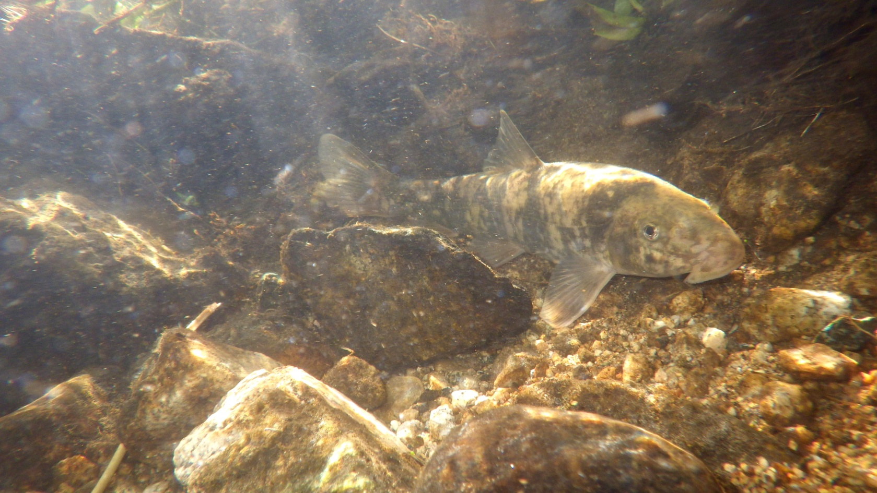
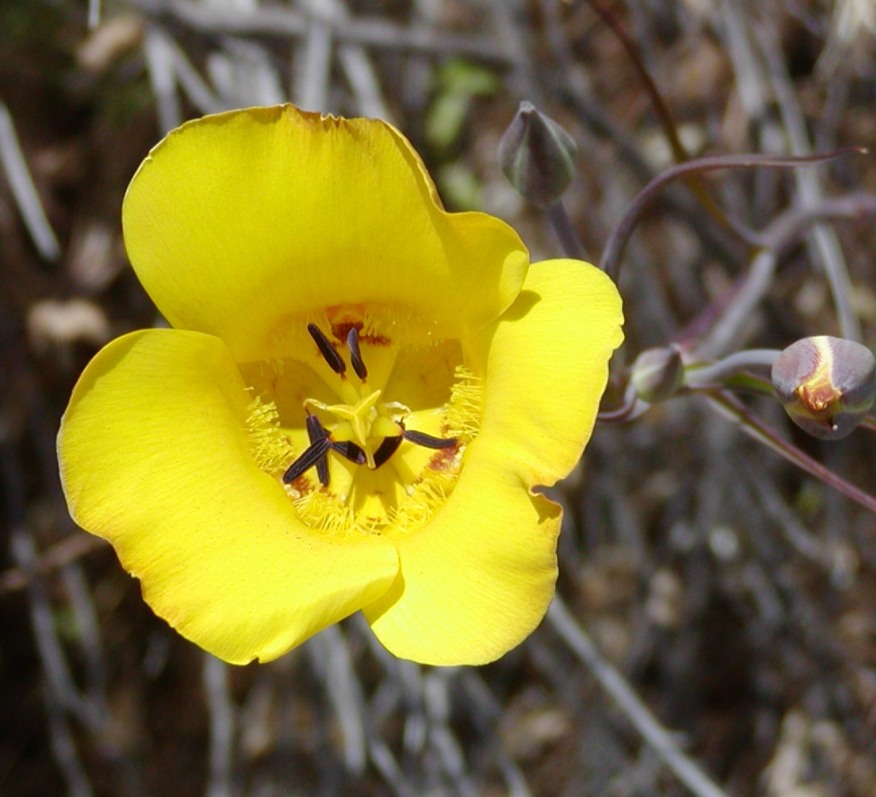
Environmental Reports
Managing Risk and Resource Management – July 16, 2019

Slide 2

Who we are IN RM?
Ann Johnston
  Principal/Vice President
  Psomas Resources Management Team
Collection of RM Professionals:
  General Biologists (Plants/Animals)
  Botanists (Plants)
  Wildlife Biologists (Animals)
  Arborists (Trees)
  Restoration Specialists (Native Habitat Landscapes)
  Regulatory Specialists (Stream/Wetland Permits)
  GIS Specialists (Maps/Calculations)

Slide 3
What is Resource management??
Resource Management provides a variety of biological and project management consulting services, including technical support to CEQA and NEPA documentation; biological resources surveys and assessments; habitat restoration planning and implementation; regulatory services and resource agency permitting; and Graphic Information Systems (GIS) graphics and spatial analyses.
Four Main Disciplines
  Biological Resource Management
  Habitat Restoration
  Regulatory Compliance
  GIS Support/Analysis

Slide 4






Resource Management Risk
Risk is based on:
  Local, state, and federal laws regulations
    More regulations involved = greater risk
  Complexity of project
    More complex = greater risk
  Opposition to project
    More opposition = greater risk
Your acceptance of risk is related to:
  Potential projects costs
  Time delays
  Both
“Take calculated risks. That is quite different from being rash.” General George Patton.

Slide 5
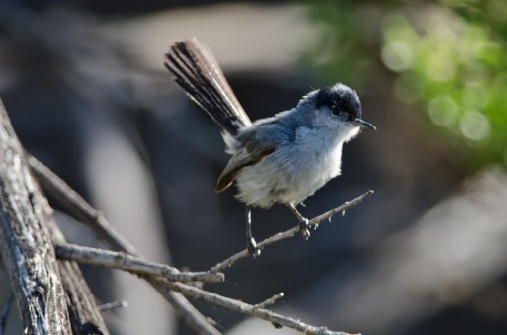
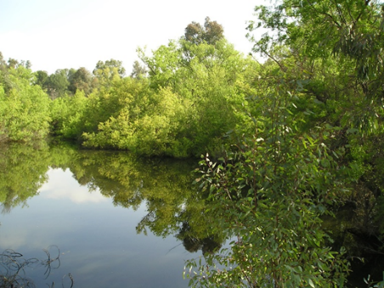
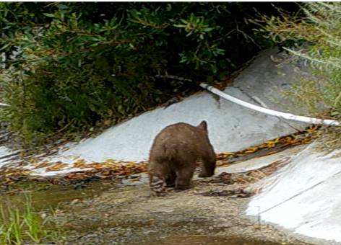
Examples of Potential Risk
  State or Federally Listed T/E Species
  Regulated by state and federal law
Riparian/Wetland Resource
  USACE, CDFW, RWQCB, and CCC
  Wildlife Movement
  CEQA and local agencies (key for linear projects)
  Local Policies
  HCPs/tree ordinance/etc.

Slide 6
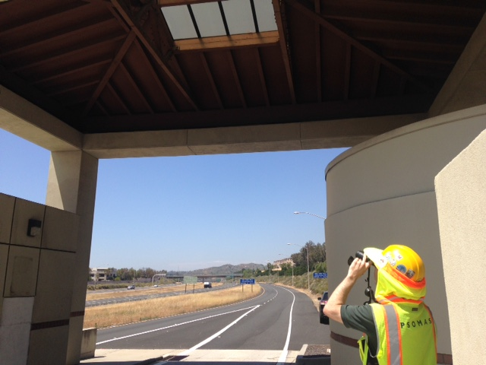
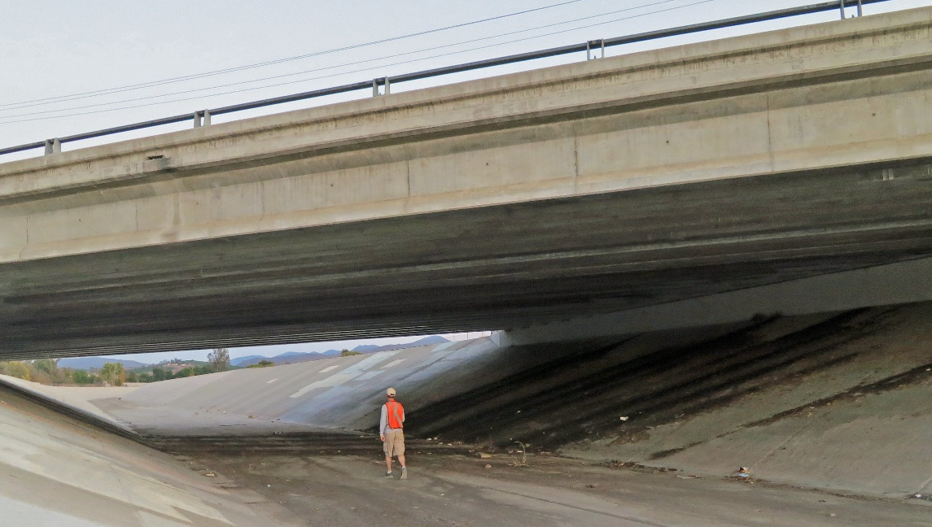
Example of Potential Risk – PRESNCE OF Listed Species
“Life finds a way.” Dr. Ian Malcolm, Jurassic Park
  State or Federally Listed T/E Species
  Regulated by state and federal law
  Species don’t know they are in your Right-of-Way
  Sometime structures or habitat are made that attract species – regardless still protected.

Slide 7
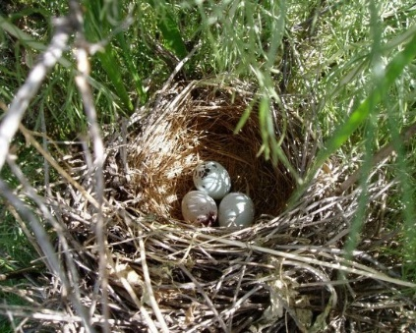
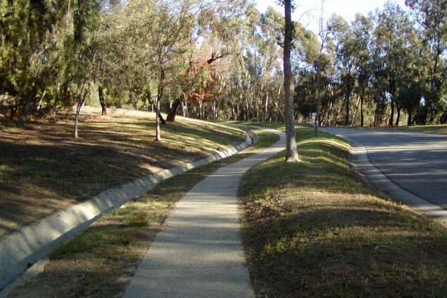
When is Risk the greatest?
  Risk is greatest when it impacts:
    Project Schedules
    Cost
    “Build-ability”
  Important Time Frames
    ROW Acquisitions
    Prior to Construction
  Risk is not knowing or not understanding what you have.
  Risk is not knowing the process and the limitations to solve issues – sometimes they are outside of your control.

Slide 8
RISK IN ROW ACQUISITIONS
  ROW Acquisitions
    Need to know what you do know.
    Need to know what you don’t know & how to get it.
    Need to know the process and limitation of what can be done.
    You can solve the issues sometimes it just takes more time & money than the project can bear.
    Sometimes it is out of your control.

Slide 9
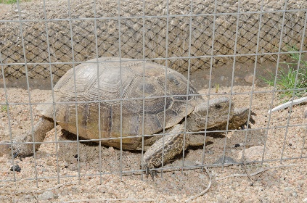

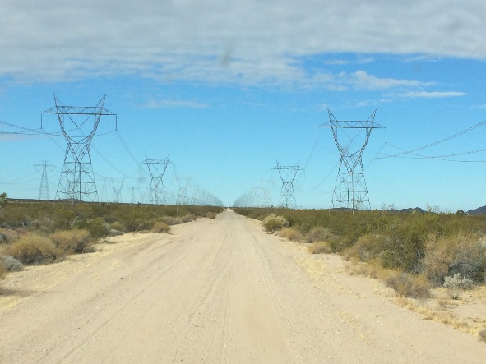
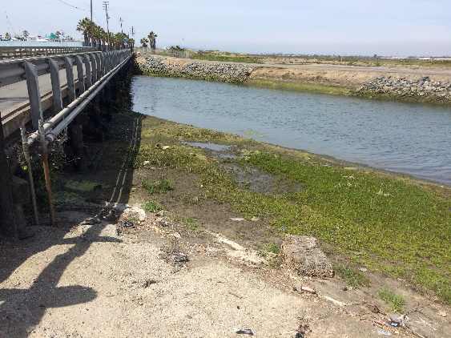
Risk IN row CONSTRUCTION
  Critical time is prior to construction
  Risk is not knowing or not understanding what you have
  Understanding the project obligations in the Mitigation Monitoring Report is critical.
Bottom Line:
Be Informed!!!

Slide 10
Mitigation monitoring report = risk reduction
  Levels of Mitigation in ROW
  AVOID MINIMIZE RESTORE COMPENSATE
  AVOID: Elimination of adverse and unnecessary impacts
  Example: relocating or redesigning project or implementing seasonal restrictions on construction (ie., during the nesting bird season)
  MINIMIZE: Reduction of impacts to the maximum extent practicable
  Example: reduce roadway footprints or using pilings instead of fill in wetlands
  Bottom Line = If you don’t meet your obligation for mitigation in the ROW, you put your project at risk.

Slide 11
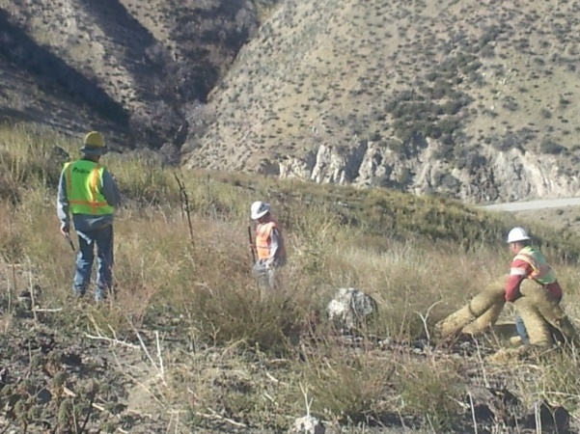
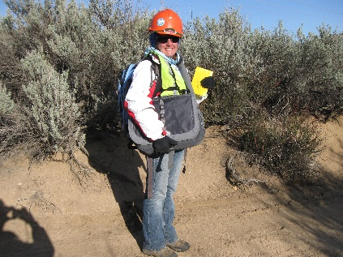
What to look for in
RM reports and MMR
Good information is critical:
  Get it early & keep it current
  Accurate project description
  Precise maps – include greatest extent of project impact
  Clear “implementable” mitigation measures
  If information is not clear – ask for clarification

Slide 12
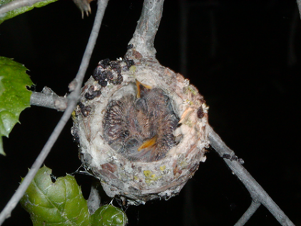

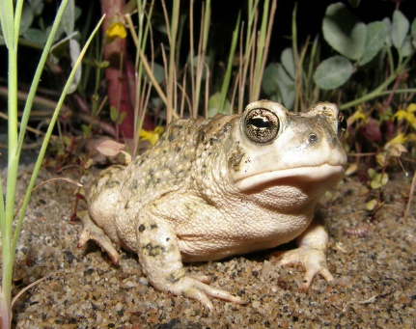
Take Away Messages
Understand where your risk comes from (species/agencies/non-compliant contractors)
Timing is important – information early is the best defense
Get the info – read and understand the implications
Be proactive – ask team members early on about potential risk

Slide 13
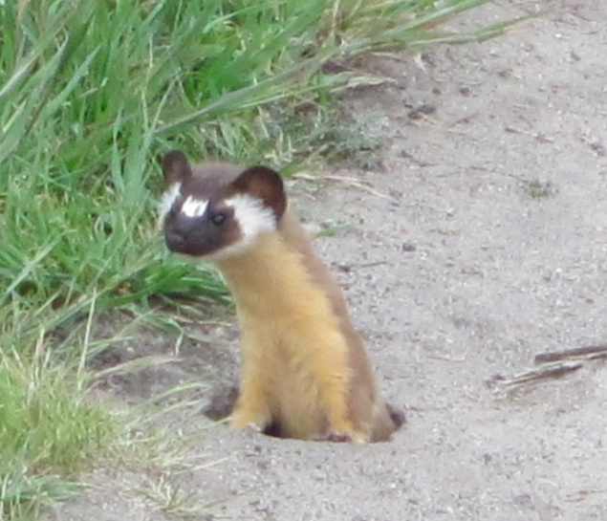
When is Risk the greatest?
Questions????

