Slide 1
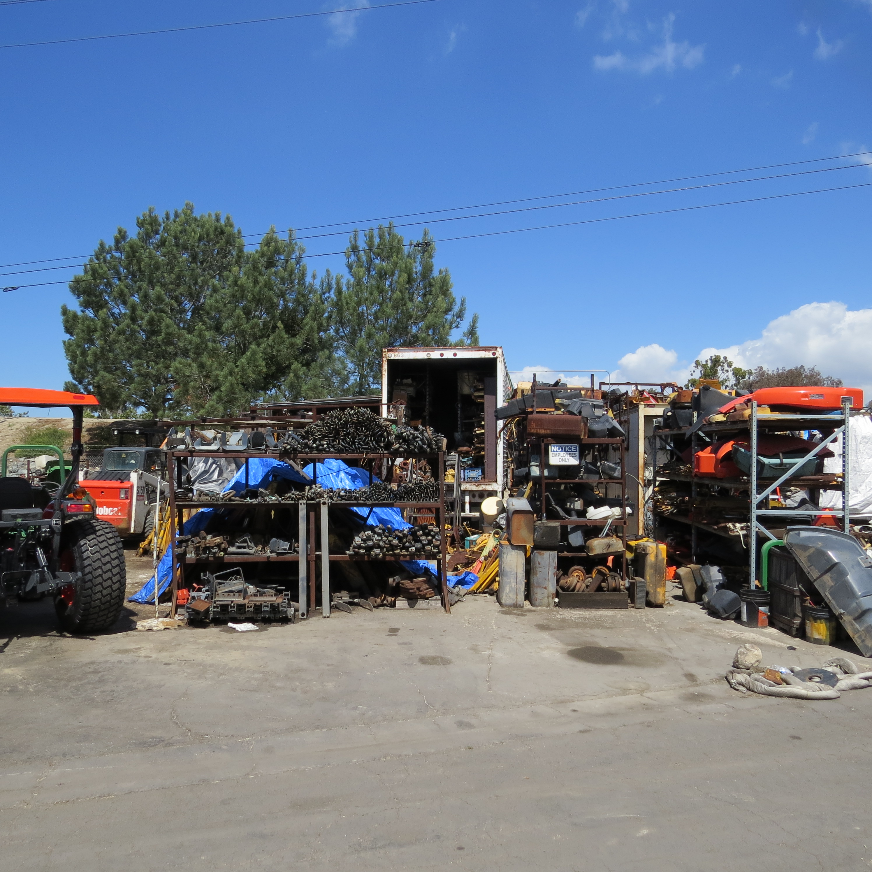
Decoding environmental reports to manage risk
EKI environment & Water
Steve Figgins

Slide 2
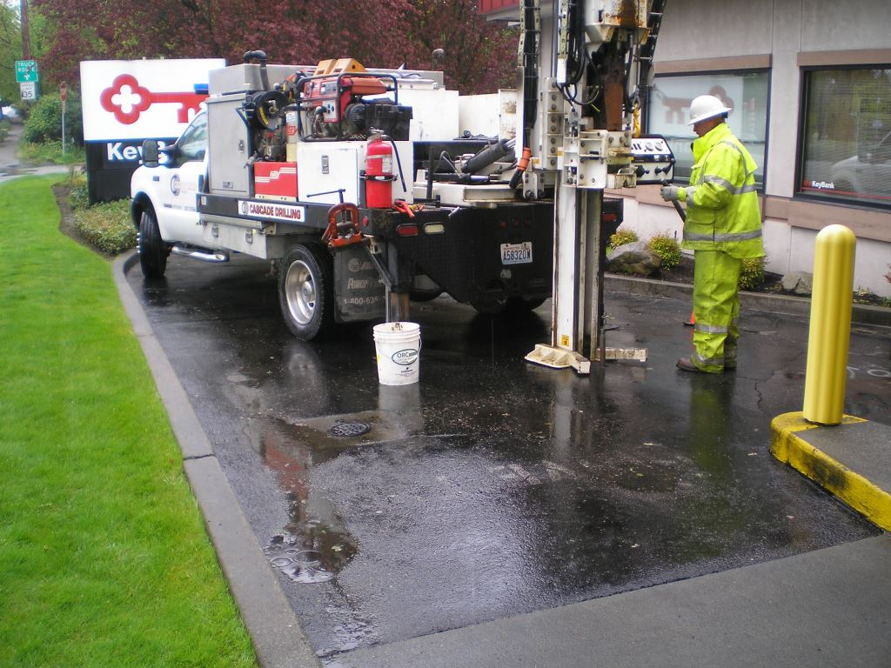
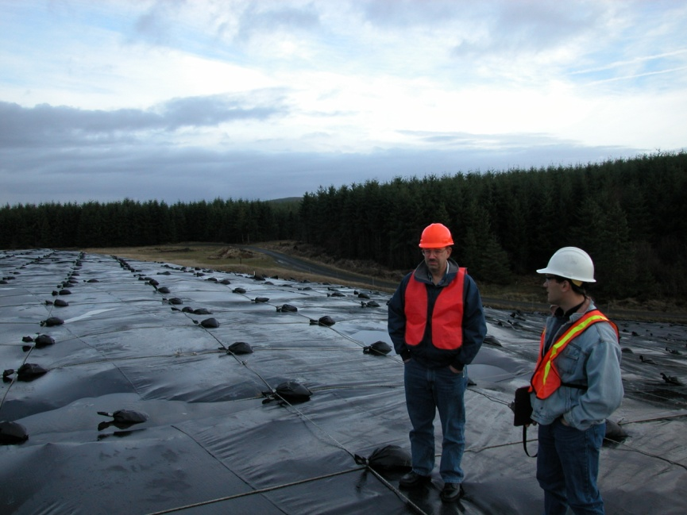
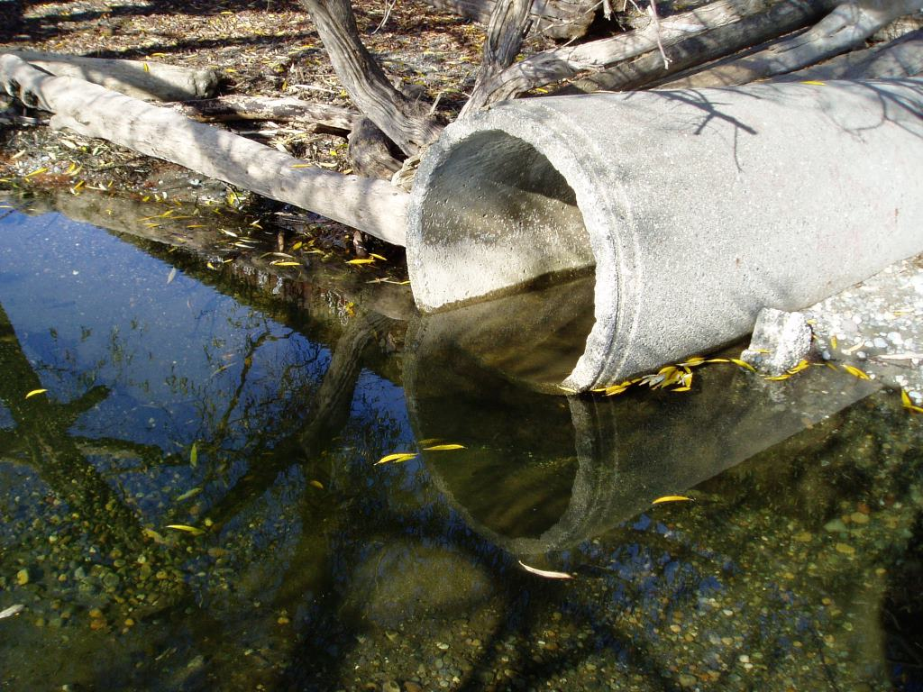
Today’s topics
Managing Risk- What Risk?
Using existing data, but be careful….
What to look for in Phase II reports
Lessons learned
Takeaways

Slide 3
Risk Tolerance
Examples of Risk Tolerance
In your investment portfolio
If you are young, your strategy is likely aggressive
If you are closer to retirement; it’s probably more balanced
Once you retire; very conservative
Let’s look at some Phase I Recognized Environmental Concerns (RECs):

Slide 4
Risk Tolerance
Notes:
For consistency and a professional look, use one font throughout your presentation. Arial is the font shown above.
You can adjust the font size and use ‘bold’ to create emphasis.
You can also use color for emphasis. On the pages in this template, I make a few suggestions. I (Julie) am happy to show you how to use the Farallon specific blue, or green or brown. Adding a shadow helps with emphasis (“S” button next to the bold, italic and underline buttons).

Slide 5
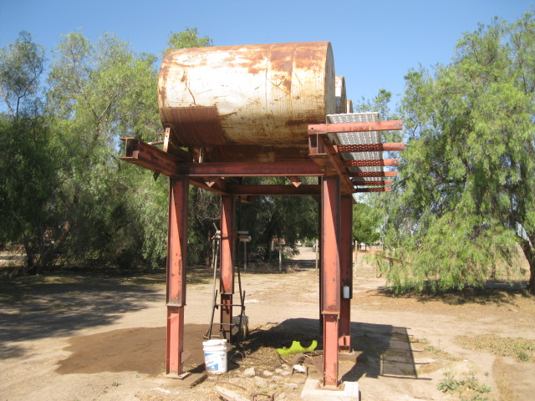
Risk Tolerance
Notes:
For consistency and a professional look, use one font throughout your presentation. Arial is the font shown above.
You can adjust the font size and use ‘bold’ to create emphasis.
You can also use color for emphasis. On the pages in this template, I make a few suggestions. I (Julie) am happy to show you how to use the Farallon specific blue, or green or brown. Adding a shadow helps with emphasis (“S” button next to the bold, italic and underline buttons).

Slide 6
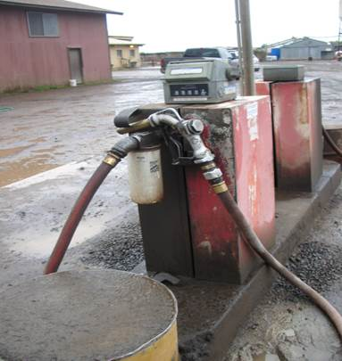
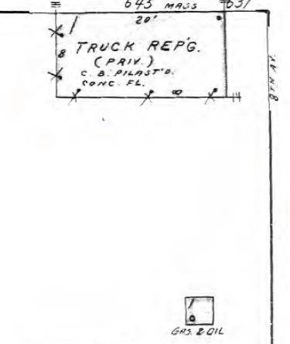
Risk Tolerance
Notes:
For consistency and a professional look, use one font throughout your presentation. Arial is the font shown above.
You can adjust the font size and use ‘bold’ to create emphasis.
You can also use color for emphasis. On the pages in this template, I make a few suggestions. I (Julie) am happy to show you how to use the Farallon specific blue, or green or brown. Adding a shadow helps with emphasis (“S” button next to the bold, italic and underline buttons).

Slide 7
Considerations using other people’s data
Why is this a good idea? Can it be a “Suspect” idea?
Understanding the previous consultant’s position
Were they working for the Buyer or the Seller (who paid for it?)
Why is this important?
What do you do with One Data Point?
How about one Groundwater data point?
Understanding your client’s Risk Tolerance
Understanding what the risk is and what they will tolerate

Slide 8
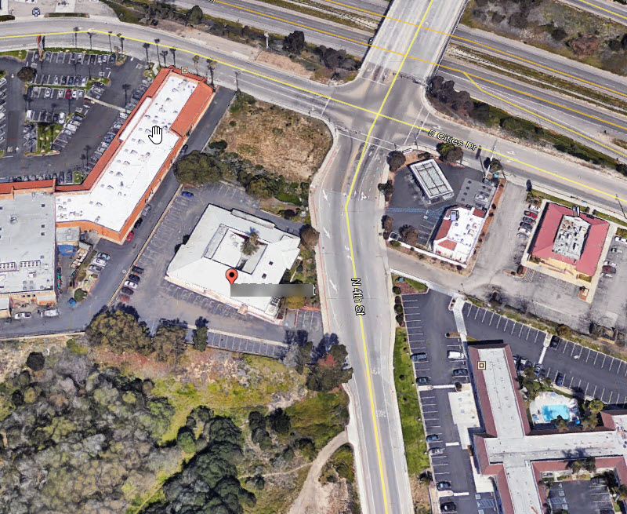
One data point…really??

Slide 9
WhERE ARE THE CONTAMINANTS?
In Soil?
In Groundwater?
In Both?
Are Vapors an issue?
Is the facility still operating?
Do they still use the same chemicals that are in the subsurface?

Slide 10
OK they did a Phase II, Should I freak out?
Why did they poke holes in the ground?
What did they analyze for and find?
How thorough were they?
What’s missing from the Phase II?
Would you buy it?

Slide 11
Will more data help?
There is an order to how a site should be investigated
Presence/Absence methods (soil gas) before media specific (soil/groundwater)
Example – San Diego
How many holes are enough or too much for subsurface exploration? So for 60 acres, is 3 holes enough? What chemicals might have been used at the site? What was on the site historically? What will the site be used for? Any emerging chemicals?
Does each phase of work provide enough data to make an informed risk management decision?

Slide 12
Due Diligence/REMEDIATION- LESSONS LEARNED
Spend more money on investigation to lower your remediation $$. During remediation, more sources can turn up.
Remediation is often a multi-phase program.
Work with the regulators, they can change their minds, or retire. Consider a non-adversarial relationship with them.
Source removal with excavation: despite your best efforts, you will remove more soil than you estimate.
Site cleanup and closure always takes longer than anticipated. Start early.

Slide 13
Today’s take away Points
Understand your risk management position
No Risk?
Some Risk?
Experienced and can manage Risk?
Use Existing data…. but not “Blindly”
Carefully evaluate any existing Phase II Site data
And how that applies to your proposed site use
If you procrastinate, YOU increase your own costs, be proactive

Slide 14
Thank You and Happy Decoding!
Burlingame | Irvine | Larkspur | Oakland | Sacramento, CA
Centennial, CO | Salem, NH
ekiconsult.com

